Slide 1
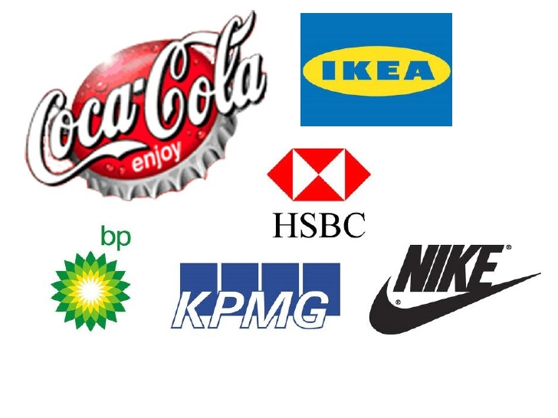
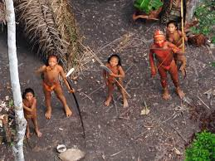
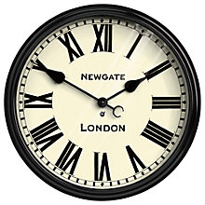
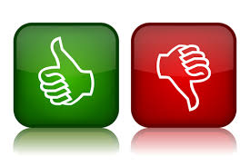
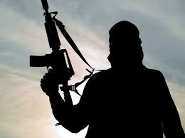
What is the relationship between globalisation and digital forms of communication?
Globalisation is .a much used term which is used to describe the process which has been undergoing for 1.8 million years when early humans began moving out Africa to different parts of the world. As communication and transport developed with greater efficiency, more and more people became interconnected (Giddens 1990)
When the internet was created in 1983, it made communication much easier and the previously uncontacted became part of the global village resulting in national boundaries becoming less significant and businesses being able to operate internationally (trans national corporations - TNCS).
Globalisation
Definition
Problems with definitions
Why are we interested?
Wiseman (1998) warns that the term can be misused and misunderstood and needs careful consideration.
It should involve a variety of social, economic, cultural and political factors which do not have to occur in equal amounts.
The effects of globalisation can be both positive and negative; for some it may result in marginalisation and exclusions such as those within a digital divide such as poverty or state restrictions.
It does not always occur at the same rate everywhere; for example in less developed countries digital communication may be used much less.
Sometimes the definition assumes that globalisation results in homogenisation however it can sometimes lead to diversity, glocalisation or even resistance to protect certain rights and cultures such as tribes.
It assumes it always results in social change towards postmodern characteristics such as individualism and choice however some may see globalisation as threatening and can lead to further resistance such as religious fundamentalists.
If human history was equivalent to a 24 hour clock day, not much would have happened for the first 23 hours; agriculture would appear at 11:56pm and modern societies emerge at 11:59pm. More change has taken place in the last 50 years than any previous changes.
.

Slide 2

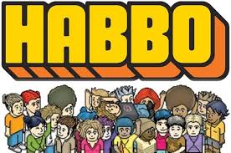


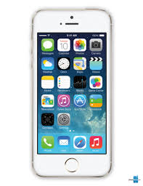
Developments in digital forms of communication in a global society
Digital communication has to led to an increase of online communication leading to the idea that time and distance do not matter and therefore the world has shrunk. The global village refers to the ease with which it is to contact and maintain relationships with people all around the world.
Social networks go beyond face to face relationships; they are platforms for creating virtual networks. They can be in relation to friends, work, family or hobbies and interests.
As globalisation increases; the economy and employment has changed and people may rely more on their social networks; this can be related to social capital. An example of this is LinkedIn which has more than 20 million users worldwide.
A networked global society refers to the idea that in a post industrial society the focus is on information; those with it create social networks which can results in greater employability and hierarchal status – again a social capital.
Castells (2000) – a Marxist claims that although society remains capitalist the focus has shifted from oil, gas and electricity to a focus in information and power now rests in networks.
Developments
Global Village
Social Networks
Virtual Communities
Digital Revolution
Media Convergence
Big data
Social Media
Digital Revolution refers to the massive and rapid advances in technology; the move from analogue, mechanical and electrical technology to digital technology and communication. New forms of digital communication are called new media and fall into two categories
Extension and development of existing platforms for example newspapers now also being online and development of satellite TV.
New platforms such as mobiles,, laptops and tablets that have access to apps that allow communication in novel and dynamic ways and also to help manage lives, relationships, shopping, diet, health and so on. These can be highly individualised.
The way information is collected and stored has changed; big data refers to large data sets analysed digitally to reveal patterns, trend and links which is usually collected through commercial companies.
Volume – Even though the amount of data has increased, by storing it digitally the space required is less and makes it easier to filter out that which is not relevant
Velocity – It is streamed at unprecedented speed and needs to be dealt with promptly
Variety – It comes in all sorts of formats; statistics, numerical data, email, video, audio etc.
Variability – Sometimes it comes faster than others e.g. when something is “trending” or after a natural disaster
Complexity – It can come from many sources and may be encrypted.
A virtual community is a social network of individuals who create an online community which may or may not reflect their offline lives. They may cross geographical, political and social lines and are becoming much more complex and in some cases realistic. They allow people to share interests and create and transform identities and may include message boards, online chat rooms and virtual worlds.
Carter (2005) conducted research in Cybercity with over 1 million uses; for over three years. She carried out participant observations, questionnaires and offline interviews and found that people are investing more time in online relationships and people are more likely to continue these relationships in their offline lives and meet in person.
Boellstorff (2008) conducted two years of work in Second Life using participant observation and interviews and found very little regulation, reporting on cases of rape, prostitution and pornography.
Any platform used for making networks such as Second Life, Facebook etc. The first mass usage was Cyworld in South Korea in 1999 however the most widely used is Facebook.. There are 15 million uses of Twitter of which 80% access via their phone, 31 million uses on Facebook with the majority between 24-35 however new Facebook profiles being created has plateaued. LinkedIn has 20 millions uses and Snapchat has the most users aged 13-20. It is estimated 41% of global population use social media.
When a range of information can be combined and delivered in one format for example videos, texts and emails on a phone. It is a Marxist concept that suggest capitalism is supported due to this making advertising easier.

Slide 3
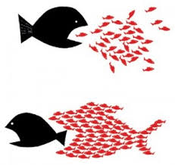
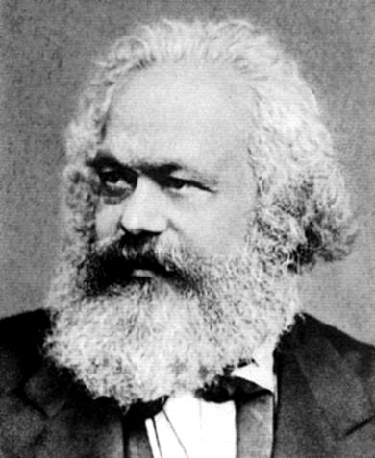
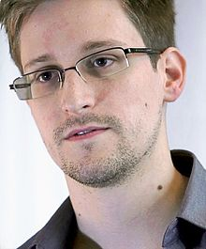
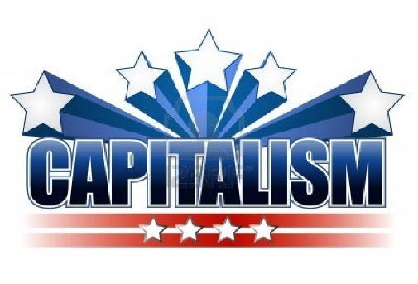

The Marxist Perspective
Marxism
Class
Proletariat
Conspicuous consumption
Revolution
Control
Karl Marx
Capitalism
Exploit
Bourgeoisie
Marxists argue that digital communication is not new but simply a different version of other forms of communication whose effects have been exaggerated by postmodernists..
Key Points
Cornford & Robins (1999) argue that digital communication is a new form of open communication which can lead to greater inequality and the spread of capitalist ideas. They argue the people who own and create the digital media are capitalists who want to make profit and ideologically control the masses. They state that in the past the ruling class owned the means of production which led to a profit but now the ruling class have had to find another source; digital media. This can be further demonstrated by the media being owned and controlled by a generally small population – for example Rupert Murdoch owns over 1/5 of the UK news. This is referred to as a monopoly of ownership rather than pluralism.
Evaluation
However, globalisation has led to your class becoming just one part of many that shapes your identity, ethnicity for example may be much more important. This can be linked to there being a wider variety of news channels and access relating to class is not so much of an issue as it was previously.
Media convergence provides greater opportunity for marketing strategies creating vast opportunities for profit creating an even greater platform for control and shaping of the masses and to encourage the passive acceptance of capitalism without questioning inequalities therefore reinforcing existing forms of inequalities and new and subtle ways to control people. Neo Marxists link this to cultural hegemony and the media reflecting the ideas of the ruling class.
There are only small social class differences in family size today, unlike in the early 20th century when working class families were generally larger than middle class.
The lack of regulation is an issue – being mediated by private companies rather than the state means that there is a lack of social control in what happens in virtual reality and what happens in offline lives. It is therefore considered yet another method of surveillance, a form of subtle observation to control and regulate people to suit the wealthy. It is possible to argue there is little economic incentive to protect vulnerable groups online.
The typical adult spends 8 hours and 41 minutes online compared to only8 hours and 21 minutes asleep. Marxists suggest that the internet and digital communication is a form of entertainment that provides no real threat to capitalism
Digital forms of communication have also led to social protests that challenge inequality worldwide. This could be linked to the Arab Spring and Black Lives Matter.
Recent concerns over monitoring suggests to Marxits a threat to individual liberty and freedom. Cronford and Robins (1999) argue that digital communication is simply a way of capitalism controlling the masses through subtle surveillance under the guise of protection form extremism and criminal acts. This can be linked to the often unclear way that companies such as Facebook use private data. This can be linked to the Snowden Report
Despite being developed over 100 years ago Marxism still offers some interesting ways of looking and understanding the role of digital communication in a global context.

Slide 4
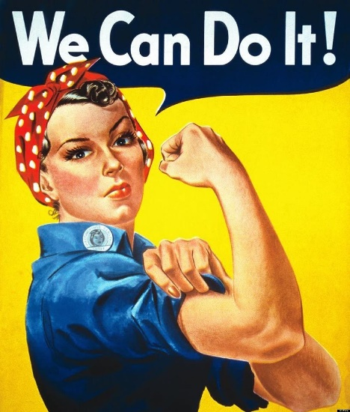

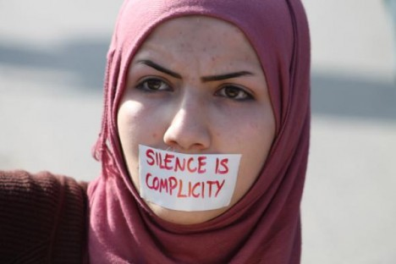

The Feminist Perspective
Feminism
Gender
Liberal
Radical
Black
Control
Marxist
Patriarchy
Exploit
Oppression
Women use digital media more than men with Pinterest and Instagram 70% female users, whilst only 13% of Wikipedia contributions ore from women and only 13 of Twitters most influential users being female. Suggesting that again there is patriarchy in this institution and strong hegemonic male discourses. In a relatively new development cyber feminists seek to overturn the idea that males are the innovators of the internet and digital communication.
Key Points
Haraway (1985) wrote a ground-breaking article “A cyborg Manifesto” and felt that women should be included in all technological advances arguing that women cannot be essentialised and states that cyborgs will allow people to transcend gender restrictions n the internet. Therefore technological advances will allow women to create new forms of identity not bound by dominant patriarchal discourses about gender.
Evaluation
Argue that global media has led to the exploitation of women however it has also led to a decrease in muted voices.
More recently, Nakamura (2011) notes that a diverse range of women are gaining a presence online such as suppor networks that help muted voices. An example of this is the Everyday Sexism Project founded by Laura Bates.
Men are also being exploited online however most women only focus on female exploitation.
Globalisation has led to more opportunities for exploitation, with women now at more risk of being bought, sold and consumed as commodities by tourists, traffickers, pimps and those seeking sexual entertainment. This is further emphasised by the lack of legislation to support such vulnerable groups. Feminists argue this is because government is a patriarchal society. The internet has only increased the problem as national boundaries have become less significant with the internet assisting in the covert arrangements.
In 2012-2013 there were 18,8887 reports of child sexual exploitation and a huge increase in sexualised violent imagery such as revenge porn which is hardly ever prosecutable due to lack of evidence.
However liberal feminists recognise that men are also included in this global exploitation but state that it is overwhelmingly women at risk; a reflection of existing inequalities.
Practical responses from feminism is the fourth wave of feminism defined by the development of technology in the 2000’s and an attempt to increase muted voices. New groups such as Mums net and the Blurred Lines campaign illustrate the new ways that feminism is responding to the rise of global digital communication. There have also been a rise in campaigns linked to fourth wave feminism such #askhermore #yesallwomen

Slide 5
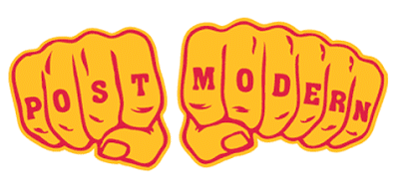
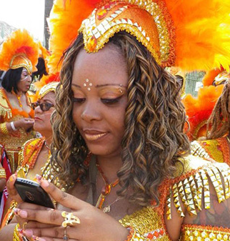
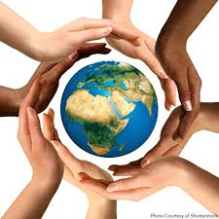
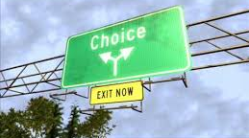
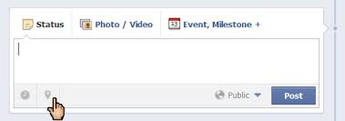
The Postmodernist Perspective
Post-modernism
Choice
Fluidity
Globalisation
Diversity
Identity
Choice
Postmodern
Shift
Fragment
They explore the way digital global forms of communication are emerging as part of a postmodern society as a postmodern society is very much linked to globalisation and rapid technological progress. Rather than arguing whether this is positive or negative they explore what is possible with new forms of technology and how it is being used.
Key Points
In the past the “self” has been understood by interpretive sociologists such as Mead and Goffman but postmodernists suggests that global digital forms of communication has changed how identity is created, negotiated and confirmed. For example the way we use Facebook reveals a lot about our identity and how we perceive our self.
Evaluation
Technological advances represent the shift from modern society to a postmodern society suggesting there has definitely been a shift.
Collins (2005) suggests that to understand society we need to understand chain of interaction – taking a micro sociological approach to social network sites such as Facebook. This will allow us to learn about how people see the world around them.
Postmodernists are also interested in the differences between online and offline lives; for example Catfish tells the story of how different they can often be and demonstrating how we can construct an identity through online media.
Rather than arguing whether globalisation is good or bad postmodernists focus on the positive and negative effects and how it is used. This creates a much more accurate view.
Bjorklund (1998) states that autobiographies used to be common at the end of your life, but now we have turned to different platforms to create an ongoing autobiography which is continually manipulated and updated. This is reinforced by Hart (2011) stating that we rewrite our autobiographies on a daily basis to reflect norms and values of society, for example posting a selfie.
Case (2007) suggests online autobiographies can be problematic for teenagers who develop an online and on offline identity and that once something is made public it is hard to remove
Elliiot (2001) is pessimistic about the fragmented nature of identity due to this split identity whilst some sociologists suggest that online posts can be culturally significant as they reflect personal opinions and feelings and helps to understand their constructed identity.
Postmodernists explore the Marxist idea of surveillance and state that stored data can help to understand identity such as information gathered about shopping habits, tastes and preferences..

Slide 6
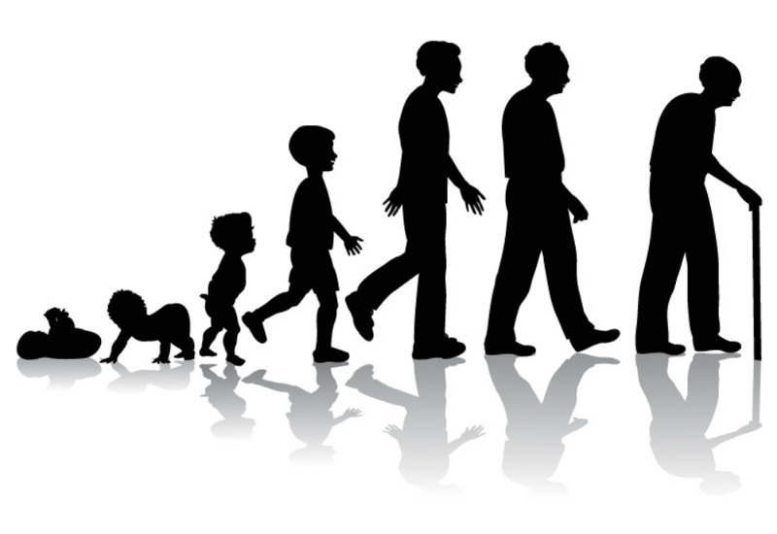
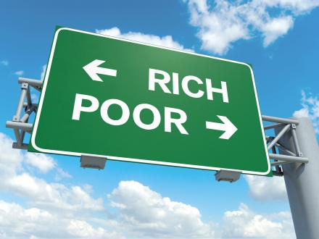
The Impact of Digital Communications
Identity
Age
Social Class
Greater technology has increased the capacity of information passed to individuals in their own homes and workplaces. This means they have greater range of choices and information on different lifestyles and cultures all over the world and therefore a greater range of information to influence identity. For example someone could discover religious practices from other areas of the globe without ever meeting anyone.
Ofcom (2014) revealed more UK adults, especially older adults are going online using a range of devices, with privacy and security attitudes varying greatly. 83% of over 18’s, 98% of 16-34 year olds and 42% of over 65’s are online. 62% of adults use a smartphone to access the internet as well as 17% of over 65’s an increase form 5% a few years ago.
Internet devices are expensive, need maintaining and regular updates. For example tablets can cost over £500 and monthly internet access over £15 a month.
Certain areas of the country do not have access to high speed broadband and there is also considerable consumer choice and competition, for example, between providers.
Increasing affluence in certain areas of the developing world has meant that traditional sources of identity such as social class have become less clear. This blurring of the lines does not however mean a more equal society however other aspects such as gender or ethnicity may have become more important.
Boyle (2007) argues that with each successive generation the greater the reliance on digital communication, so much so that there is a digital divide between the old and the young in terms of media in general. He suggests this could be due to younger people being more susceptible to learning the new skills demanded by new forms of technology and they place greater importance on their peer groups due to their high levels of socialisation during adolescence.
For those who cannot afford the internet or the connection charge they are known as the digital underclass which can result in even greater inequalities and lack of social capital due to the reliance of social networks and educational activities such as homework relying on internet access. This creates a knowledge gap that may cause individuals to feel marginalised or inferior due to their disadvantage Helsper (2012)
The emergence of online identities or avatars provides the chance to choose identity and appearance. This links to previous research by Haraway on cyborgs. Case (2007) argues technology is so embedded in everyday life we are all becoming cyborgs. Although beneficial it is also problematic as all published information remains forever.
Younger people have more free time for leisure and also have greater access to media however there are a variety of strengths and weaknesses for younger generations and media, these include;; cyber bullying, support networks, less hierarchy in knowledge, engagement in politics and youth issues, learning new skills and increasing social capital, risk of exploitation. Palmer talks about the toxic childhood with greater exposure to adult content and the loss of childhood innocence.
Mertens & Dhaenens (2010) found that of the digital divide in Brussels that lower social classes had lower internet use (81% compared to middle class at 94%). Moreover, lower social classes tend to focus on entertainment rather than the gathering of knowledge. Inconclusion, they found that social class is the most powerful social variable in the digital divide, more so than gender and ethnicity. Similar results have been found in Latin American and Uruguay.
In online settings many identity cues can be hidden, masked or misrepresented, allowing users to adopt multiple online personalities.
Online identities can overlap with offline lives with positive and negative effects. The UK’s first Police and Crime Commissioner had to resign due to tweets being uncovered from when she was a teenager that could be considered racist and homophobic.
Berry (2011) notes the digital divide between age is mostly due to a lack of interest. The elderly who do use the internet often use it for social network and for ease e.g. internet shopping.

Slide 7

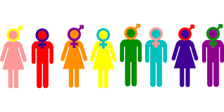
The Impact of Digital Communications
Gender
Location
Relationships
Gender differences reveal interesting patterns in the way males and females engage with digital communication. For example younger women are much more likely to use the internet to maintain social relationships.
Usage in different parts of the world reveals interesting patterns of access which may explain the uneven distribution of globalisation. In general, more developed affluent countries have grater access to and consumption of the internet.
Turkle (2011) expresses concern about the way in which communication tools distance us from one another because we are “alone together” – in the same room but using our devices to communicate with others and engage in other tasks.
Younger uses, particularly men use social media for a wider variety of reasons other than maintaining relationships, particularly entertainment..
Relationships consist of social ties between individuals that link them together which vary in strength from weak ties for acquaintances and strong ties for family and close friends. The strength can be measured in relation to time spent together, the emotional intimacy, level of intimacy and the degree of reciprocity.
In 2015, Asia made up 48.2% of total internet usage whilst Europe was 18% and North America 9.3%. However these statistics can be flawed due to population density.
Younger women spend the least amount of time searching for information; on average women have much more social media posts on Facebook (394) and make up 69% of Facebook gamers.
Li & Kirkup (2007) investigated attitudes and usage differences between Chinese and British students. There were significant differences in experiences with profound gender differences as well. Men in both countries were more likely than women to use chat rooms and emails and were also more likely to play computer games. Men were also more self confident about their computer skills and more likely to describe using a computer as a masculine skill and activity.
Activities that connect individuals directly, such as email and chat tend to have positive effects on social ties unless internet usage was not sued to develop online relationships. Kraut argues that online social ties are weaker than offline relationships but this is disputed.
In each month in 2014, 40 million more women visited Twitter than men and among the top 50 brand followers on Instagram 53% were women. Google+ was 64% male used based and 35% of men watched a video daily on YouTube.
Positive effects include the immediacy of contact with people you may not usually come into contact with due to traditional barriers to meeting people such as disability, shyness and geographical distance. Shaw & Gant found evidence that internet usage decreases loneliness and depression due to social support
Feminsists state this could be due to patriarchal ideology, gendered socialisation and gender stereotypes. Feminists such as Haraway state that women have a muted voice and are not taken as seriously online as males; they therefore need to transcend gender through the use of cyborgs.
Some countries such as North Korea have very strict access rules and there is a digital divide among most of their citizens with only trusted officials having access .
There are also strict rules in China that block certain Western websites such as Google and Facebook. China have there own version of Facebook social media platform such as QQ.
Negative effects include a lack of privacy, coming into contact with people you may not want to and it being hard to switch off which may damage offline relationships as evidence by Miller (2011) due to issues with faithfulness and potentially a rise in divorce rates.

Slide 8
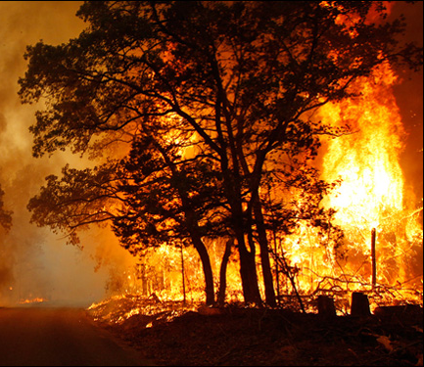

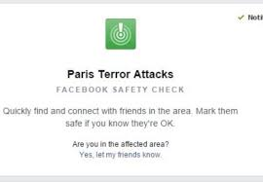
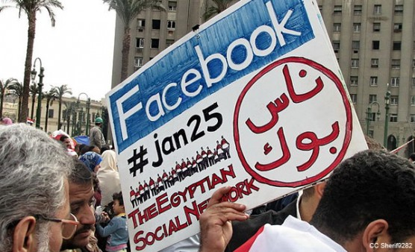
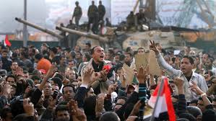
What is the relationship between globalisation and Conflict and Change?
Some sociologist argue digital forms of communication have changed the course of history on a small and large scale, however it is important not to over emphasise the role of technology in revolutions; political activists use online social media such as Facebook and Twitter as a way of highlighting abuses, promoting interaction and the spreading of information but they also merge these with offline activities such as demonstrations, protests and on the ground campaigns therefore it is tough to tell how much of an impact their online actions have. Jurgenson argues against digital dualism; there is no distinction between online and offline anymore with each having a strong affect on the other.
Sutton et al (2007) ague that new forms of communication are becoming increasingly used after disasters because they allow wide scale interaction that can be collectively useful, self-policing and can often generate information that is hard to obtain. They demonstrated this with Californian wildfires where backchanneling occurred about information through un official methods. This is further demonstrated by Facebook when they activate the “im safe” feature after disasters
Officials are concerned that such backchanneling can be problematic as it is hard to police and information may not always be accurate which can be dangerous.
Furthermore in Egypt social media has been used to provide information about safe places and places to avoid due to a presence of the opposition.
Castells argues we have become “citizen journalists”.
Conflict and Change
Sharing Information
Social Movements
Religious Fundamentalism
Recent concerns of religious fundamentalist groups such as Islamic fundamentalist group ISIS have been linked to the rise of digital communications. Religious fundamentalists often want to return to a traditional way of life without globalisation but often used modern day technologies to gain support, plan and share their activates.
Howard’s (2011) Digital Jesus study shows how like minded individuals create a large web of communications without a central leader where they can share ideologies online.
The Taliban once banned photography, mobiles and the internet because they were un-Islamic however there perspective has now changed and they now posses several internet domains and use email on a daily basis to communicate with journalists. They also use the internet for propaganda however this is a one way stream to disseminate information rather than to interact with their followers.
.
The Facebook effect by Kirkpatrick (2010) starts with a story about how a Facebook page became a catalyst for a popular movement which mobilised 10 million people in street demonstrations which curbed the violence in Colombia. This is not an isolated case and can be linked to the Arab Spring where originally social media was restricted to the elite and #BlackLivesMatter
This worked due to
Immediate communication
Ability to reach a vast number of people
Information can be shared anonymously (e.g. human rights abuses)
Groups usually unable to speak out through conventional means are given a voice
Inaccurate news able to be publicly challenged
Suppressed political activism being able to have a voice

Slide 9
Cultural homogenisation, hybridity or resistance?
Cultural Homogenisation
Cultural Hybridity
Cultural Resistance
The majority of the information on the internet is written in English, meaning that many of the ideas and content is driven by Western values and from a Western perspective – this is sometimes called as cultural imperialism. The second most common language is Chinese.
Patriarchal ideology – a set of ideas which support the view that men dominate over women in all areas of life, is used in advertising that is used worldwide. Consumerism being central to Western values mean peoples global identities are increasingly shaped by the products they choose to buy with an emphasise on buying expensive items as a signifier of status. Adverts created in the West are shown globally which increases their sales and the companies power and status.
Secular ideas and increased individualism – Western society has significant rates of secularisation and an increasingly rational and scientific world view – the programs and films that are televised worldwide are therefore reflective of these secular views.
Trans national corporations have also demonstrated the spread of Western ideas an example being mcdonaldisation – a term coined by Ritzer to demonstrate the spread of McDonalds worldwide.
American traditions have spread globally such as sweet sixteen and proms – a process called Americanisation.
Computer software is mostly Western and therefore reflects western ways of thinking such as Microsoft using Western date layouts etc.
This is sometimes referred to as fatalism – the acceptance of globalisation as impossible to stop.
In France the Government have attempted to intervene in the functioning of the market to try to protect their local cultural industries, by taking measures such as restricting the number of foreign films that can be shown.
Most people would think of Hollywood as something entirely American. However, while Hollywood dominates world cinema, American movies are subject to foreign influence. Many American movies are remakes of foreign films. For example, “The Departed”, is a remake of the Chinese film, “Infernal Affairs.” and “The Tourist” (originally the French film, “Anthony Zimmer”). In 2011 the Millennium Trilogy, a Swedish series, was adapted to film in "The Girl with the Dragon Tattoo" which grossed over $230 million at the box office.
Also, many film-making companies, producers, and actors in Hollywood are not inherently American. The Columbia Tristar and Twentieth Century Fox companies are owned by Japan's Sony and Australia's News Corporation, respectively, two foreign media conglomerates. James Cameron, producer of the movie Titanic, is Canadian. Moreover, many of Hollywood's most famous actors are not Americans. Arnold Schwarzenegger is from Austria, and Nicole Kidman grew up in Australia. From this perspective, it can be argued Hollywood is a multicultural institution. However, it is also true that actors such as Nicole Kidman and Mel Gibson, upon arriving in Hollywood, were given language lessons to help them lose their foreign accents. Hollywood producers ask actors to Americanize their accents largely over sensitivities that American audiences might perceive actors negatively if they appeared to be foreign.
Similarly, global companies have to take into account the culture of all the countries where they conduct operations or sell products. Such as adverts for McDonalds and Halal meat.
Giddens identifies a process of reverse colonisation where less powerful groups culturally can show dominance. This can be evident in the “Mexicanisatoion” of California resulting in huge amounts of Mexican food, dress and music becoming increasingly common in Californian culture. This is significant because Mexico is significantly poorer than California.
Some French people are concerned that U.S. restaurant chains crowd out their own products with fast food and argue that fast food does not belong in French society and is of lower quality than their own.
Starbucks causes cultural concerns in Italy because of the association that Italians make between coffee and leisurely sidewalk cafes. Coffee in Italy is more than a drink; it is part of the way of life. While in the United States it is common for people to buy takeaway coffee for drinking in the street or office, in Italy people usually prefer to relax and chat with peers while drinking coffee. Furthermore Starbucks coffeehouse in the Forbidden City in central Beijing was shut down in 2007 due to heavy protests. Critics called it a stain on China’s historical legacy.
Religious fundamentalists can also be used as an example here where they rejects traditional western values such as an acceptance of homosexuality and equal gender roles (ISIS)

