Slide 1
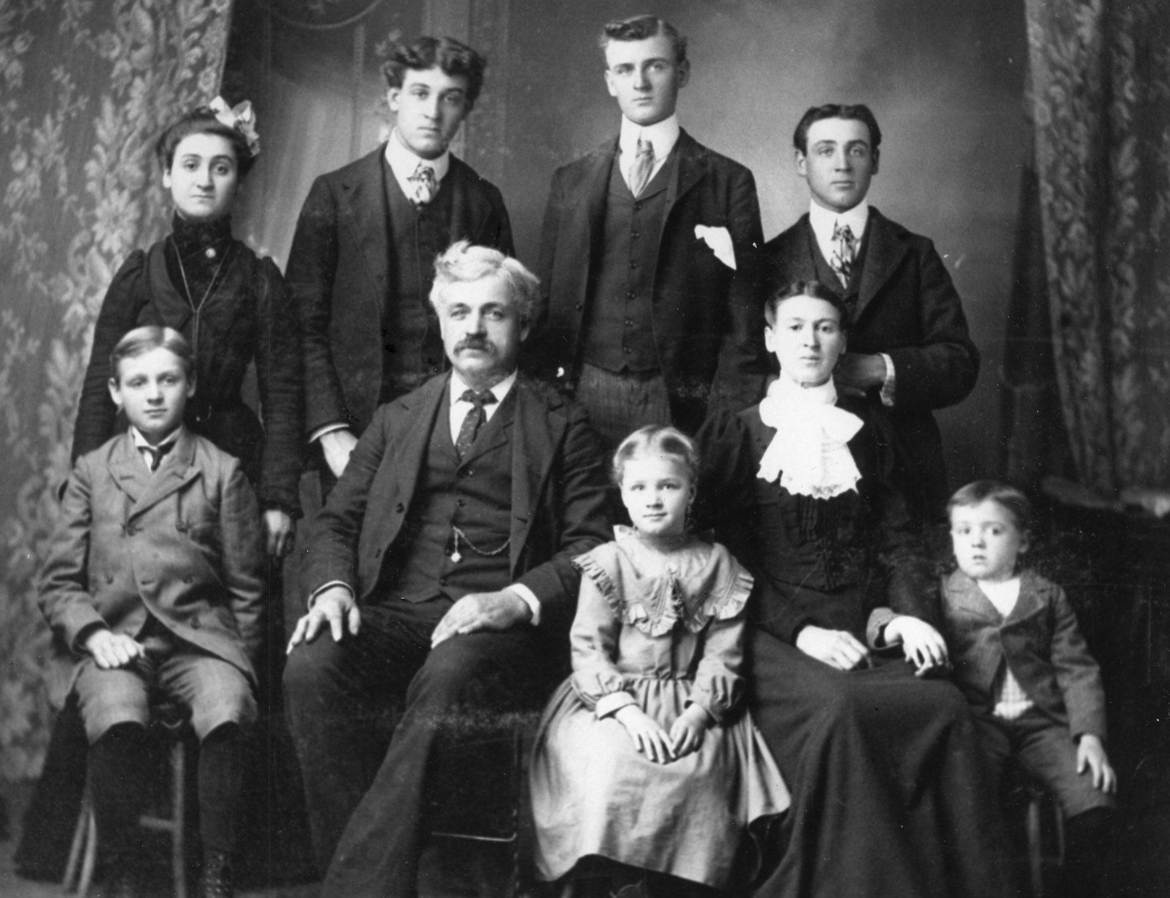
The evolving family
L/O: To explore and evaluate how the functionalist perspective explains the changing family structure.

Slide 2
Key Word Bingo
3x3 grid
Domestic Labour
Expressive role
Extended kinship networks
Heterosexual
Homosexual
Ideology
Industrialisation
Instrumental role
Kinship
Maternal instinct
Nuclear family
Pre Industrial
Sexual division of labour
Structural differentiation
Symmetrical family

Slide 3
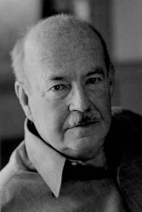
How does industrialisation have an impact on the structure of the family?
As a group, draw traditional pre-industrial and post-industrial families. Annotate the diagram with notes about life.

Slide 4
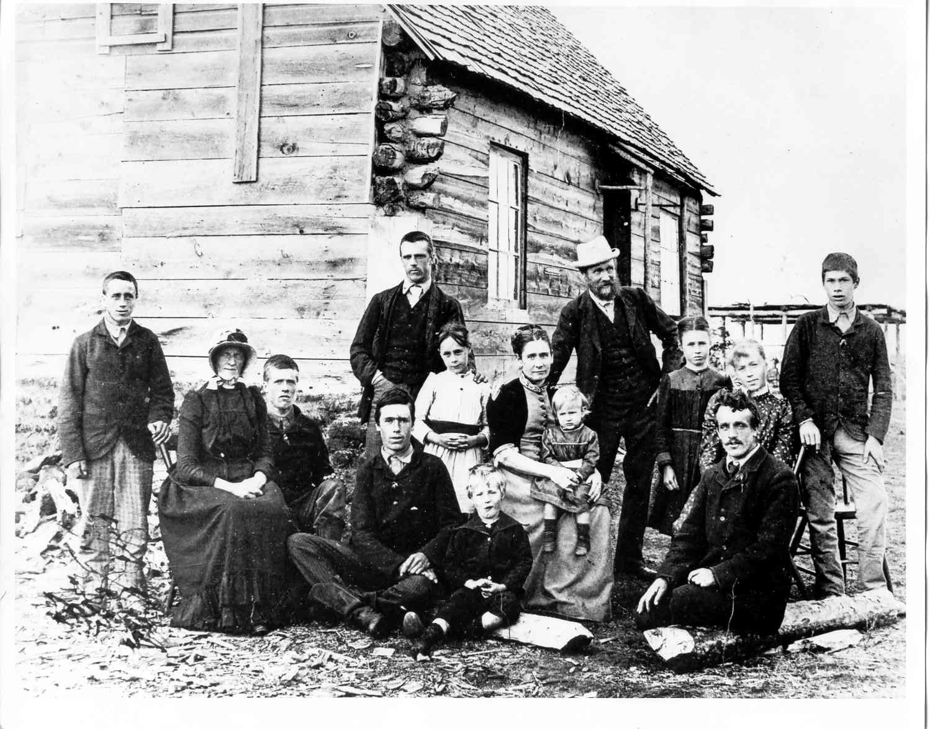
Who’s in the picture?
What are their jobs?
Why is there so many of them?
What role does their family play that benefits society?
The Criddle Family, 1985.

Slide 5
Pre industrial
Based on extended kinship networks, all working together on a commonly owned piece of land or farm.
They would not go out to work – work and home would be the same place.
They are “born into” their jobs – based on ascription rather than achievement.
Family provides functions for the members:
Members get skills and education to take their place in the family business – not literacy and numeracy
No NHS so they look after each other and provide healthcare
Provided welfare – e.g. looked after old people (who in turn looked after the kids)
Would pursue justice for any wronged family member

Slide 6
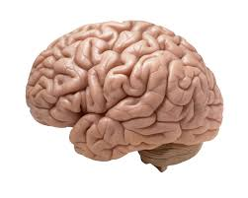
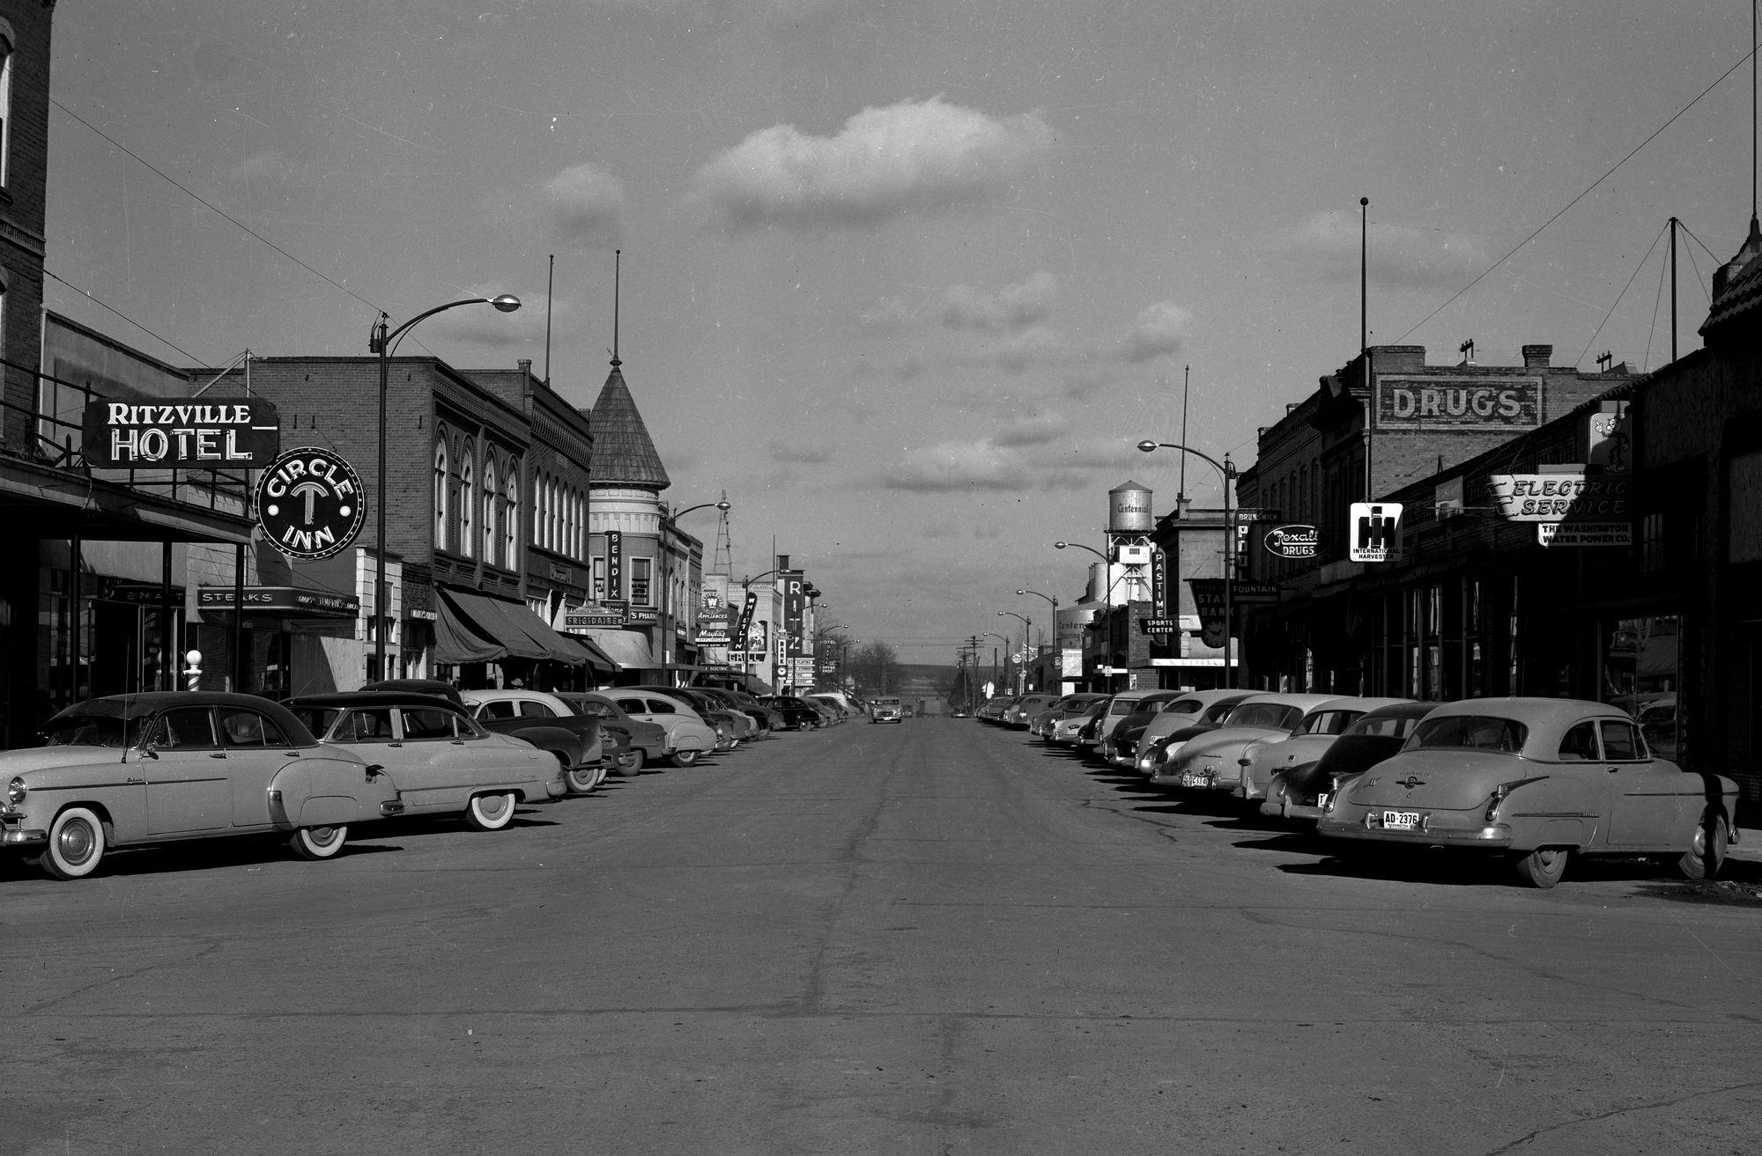
Annotate the diagram explaining why industrialisation had an effect on families.
Use your brain and think like a functionalist

Slide 7
PRE- INDUSTRIAL SOCIETY
INDUSTRIAL SOCIETY
Agricultural economy
Extended family
Labour intensive production
Family as producers
Industrialisation and urbanisation
Manufacturing economy
Nuclear family
Machine intensive production
Family as consumers
Technological development

Slide 8
Why?
People become geographically mobile (moved away from family home to work in cities) so bonds broken. (Couple more dependent on each other?)
Work based on achievement rather than ascription became more readily available (people then less likely to listen to elders)
Industrialisation changed the functions of the family, e.g. clothing factories created clothes so families didn’t have to.
Home and work place separated
State took over welfare (education and health) so families only have to do the 2 functions: socialisation of the child and stabilisation of the adult.

Slide 9
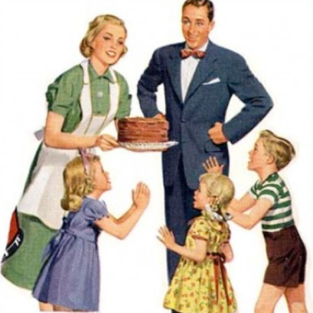
To look after the children
Meet family’s emotional needs
Socialisation of the child
Homemaker
To achieve success at work
To bring home money
Provide financial stability for the family
Breadwinner
Natural roles formed because of biological differences.
Maternal instincts!!!

Slide 10
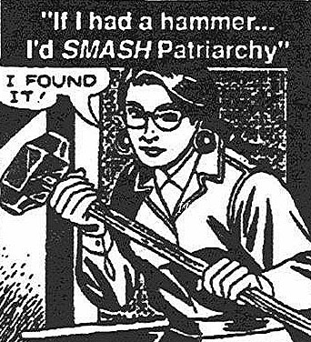
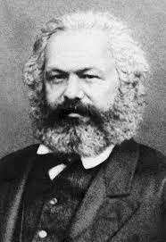
Historical perspective
Faria & Becca
Daisy
RadFem perspective
Amelia
Marxist perspective
MarxFem perspective
15 minutes
Read the information you have been given and make a poster (10 words max) to explain the criticisms.
Luke

Slide 11
Exam Question
Outline and evaluate the view that the nuclear family evolved to meet the needs of a modern industrial society. (20 marks)
PEEL
Point, Evidence, Explain, Link/criticism

Slide 12
How to structure a question
INTRO
Briefly define key terms, give brief examples of points for you are going to explain in the essay and 2 brief points against
MAIN BODY
4/5 paragraphs ish!
PEEL
2 for, 2 against (or more)
CONCLUSION
Summarise your viewpoint. BE BRIEF.
DO NOT USE “I”
20 minutes!!!!!
Refer to the sociologists by name “Parsons suggests that”

Slide 13
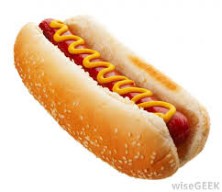
Draw a hotdog and label
The bread bun
What have you learned that underpins the meaty bit?
The sauce
Give a tasty fact about what you’ve learned (the flavour)
The meaty bit
What is the most important thing to take away from today?

Slide 14
Industrialisation
Outline and evaluate the view that the nuclear family evolved to meet the needs of a modern industrial society.
Criticisms
Key terms/people
Pre industrial

