Slide 1
Corporate Crime
Corporate Crime covers a wide area of offences and is heavily linked to the topic of White Collar Crime examined by Marxists in particularly.
Corporate Crimes are offences committed by corporations/ businesses such as:
> Not having correct permits/ licences
> Failing to comply with health & safety/ other legal regulations
(As you can see this covers a very broad definition of crime)
> This differs to ‘Occupational Crime’ as it relates to companies (or people representing companies) committing crimes for the gain of the company as opposed to people committing crimes against their company.
> Despite the seriousness and huge scale of corporate crimes we often only hear about low-level street crime – Why might this be?
> Can you think of any examples of what the term Corporate Crime might cover?

Slide 2
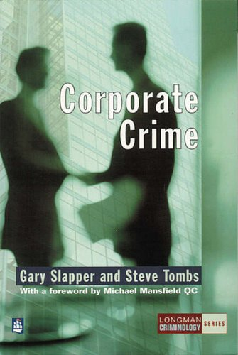
Slapper & Tombs (1999) suggest that there are 6 main types of Corporate Crime:
1) Paperwork & Non-Compliance:
> Having incorrect/ no permits or licences and/or failing to comply with legal regulations (often health & safety regulations )
> E.g. Herald of Free Enterprise disaster 1989: Capsized & a 197 people died as rules governing the closer of bow doors was neglected.
2) Labour Law Violation:
> Includes crimes such as failing to pay legally required minimum wages, ignoring legal working hour restrictions or failing to provide correct safety equipment for workers.
> E.g. GAP using child labour in sweat shops

Slide 3
3) Unfair Trade Practices:
> Includes crimes such as false advertising, price-fixing and illegally obtaining information on rival businesses.
> E.g. UK Supermarkets were fined £116 Million in 2007 for fixing the price of milk and cheese, costing shoppers £270 Million more than they should have been paying.
4) Financial Offences:
> Includes crimes such as tax evasion and concealment of losses & debts.
> E.g. In 2001 Enron concealed debts of around $50 Billion – the company collapsed and many people lost their jobs and investments.

Slide 4
5) Manufacturing Offences
> These are offences such as misrepresentation, incorrect labelling & false advertising. They also include the production of dangerous & unsafe articles, counterfeiting & failing to recall faulty goods.
> E.g. in the 1970s the Ford Pinto, advertised as the car that gives you a warm feeling, had a tendency to burst into flames in collisions. Production continued for 8 years & is thought to have been responsible for between 500 – 900 deaths.
> A memo within the company showed that it was cheaper to compensate victim’s families $50 Million than to rectify the problem which would have cost $121 Million!
(Source: Browne 2009)
6) Environmental ‘Green’ Crime:
> SEE POWERPOINT

Slide 5
Explaining Corporate Crime
Box (1983):
Being a Marxist, Box argues that Corporate Crime occurs due to the need to maintain profits in an growing Global- Capitalist world. This helps explain offences such as:
Concealment of debts & losses to avoid bankruptcy
Illegal dumping of waste to save costs
Concealment of profits to avoid taxation
Continuing sale of unsafe goods in other countries that failed tests in their own
Concealment of dangerous products to avoid legal action
> How might Control Theory explain Corporate Crime? Think about Capitalism & Morals

Slide 6
Corporate Crime & Official Statistics
Corporate Crimes are often missing from Official Statistics or at the most the yare under-represented when compared to ‘typical’ working-class low-level street crimes such as burglary, knife crime, vandalism and vehicle crime.
> How might this be explained? (Draw on your knowledge on theories of crime).
Powerful People
R/C Control the Media
Hard to Detect
Police Priorities
Often not dealt with by the CJS
Invisible crime

