Slide 1
Social class and education
Why what your parents do
For a living matters…

Slide 2
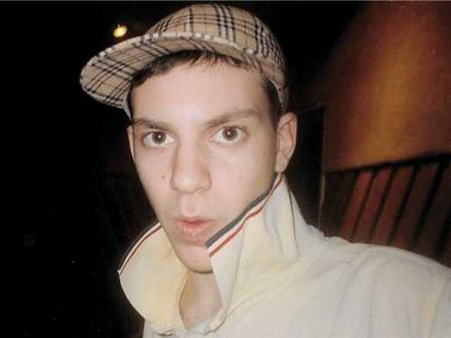
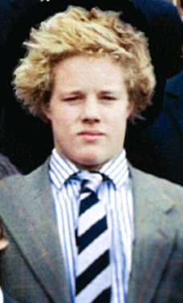
more likely to fail his education than him?
Why is he
Is he less intelligent than him?

Slide 3
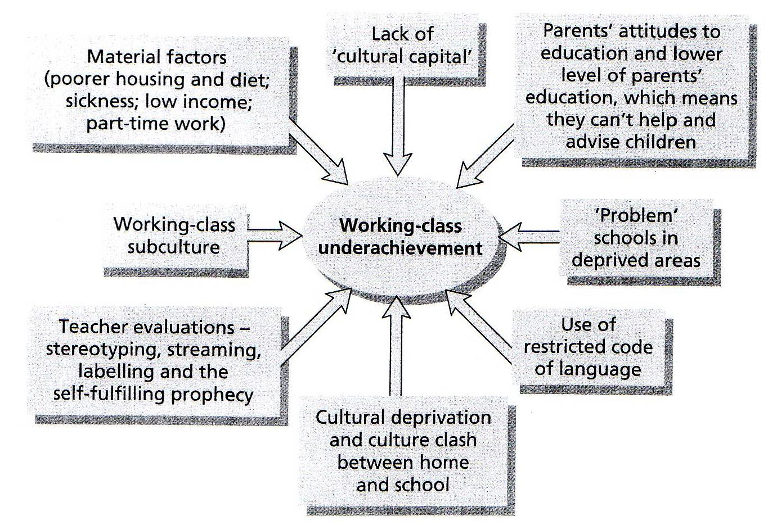
Social class and educational achievement.
Now that we’ve looked at what’s happening to kids’ results in terms of their social class background, we need to focus on why these patterns persistently occur.
Working class underachievement in education is because of...
In twos or threes, take 10 minutes to come up with 8 reasons why kids from working or underclass backgrounds are more likely to underachieve in education. Mind map it, if that works for you.

Slide 4
Home background has an enormous effect on the success of children from working class and underclass backgrounds as they are more likely to suffer from cultural deprivation where they lack the knowledge and skills to succeed.
School’s boring and it’s got nowt to offer me. That’s why I usually bunk off.
I’ve never read a book at home but that’s what they want us to do in school.

Slide 5
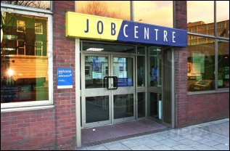
Their parents are more likely to be in unskilled occupations, if they are employed, that don’t need qualifications and therefore there will be little value attached to education in the home. Cultural deprivation also means parents won’t usually be able to help with homework.

Slide 6
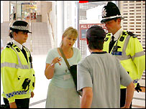
Working class and underclass children are more likely to be socialised into the value of immediate gratification; “I WANT IT NOW!!” Working class families are used to being paid low wages weekly which are generally spent straight away in a hand-to-mouth existence.
The idea of working through secondary school for no financial reward or qualifications for the next five years makes it unlikely that they will have the ‘right’ attitude to stick it out.

Slide 7
Middle class children tend to come form homes where there is an emphasis on deferred gratification. Their parents have usually waited for qualifications and endured poverty stricken student lives and have the attitude that they can wait for reward. This instils a kind of patience into middle class children which helps them maintain their focus and commitment at school.
It took my father seven years to get O and A levels, another 3 for his law degree and another year at law school to become a barrister. I’m following his example because I know I’ll be successful and loaded at the end of it all.

Slide 8
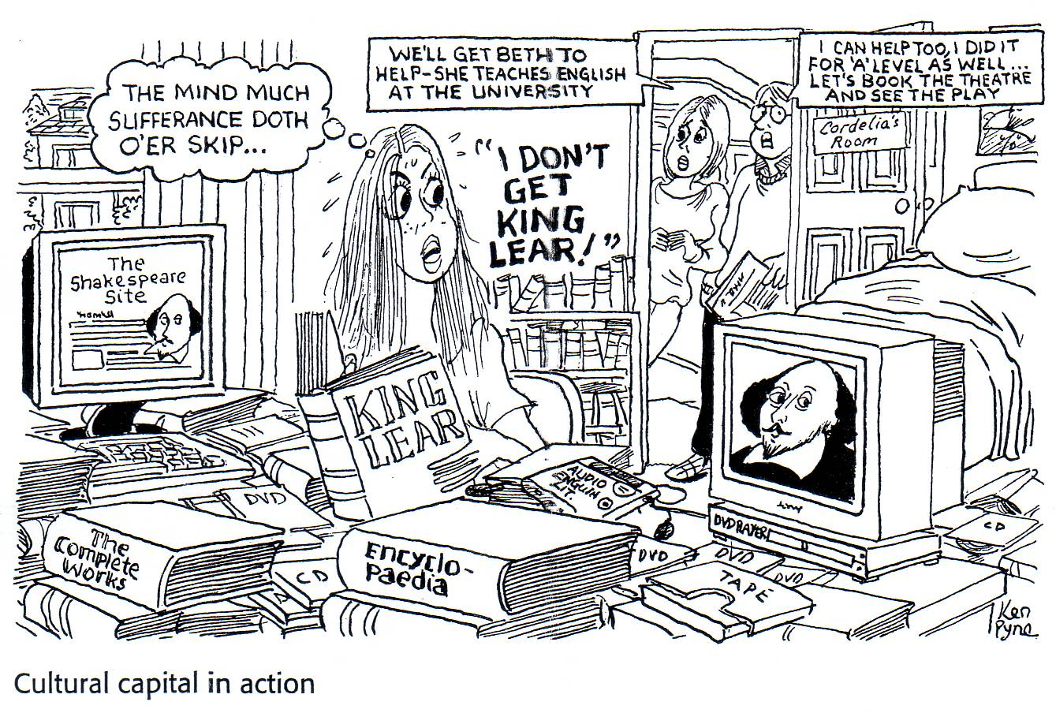
Middle class children are more likely to achieve not because they’re more intelligent but because they have more cultural capital. This is where they have the knowledge and skills that are valued in education. Middle class children are more likely to be raised by professional parents, often with higher qualifications, who will have passed some of this knowledge onto their kids.
Leisure time is more likely to be spent on educational pursuits like visiting museums as they have both the money and the attitude / appreciation.

Slide 9
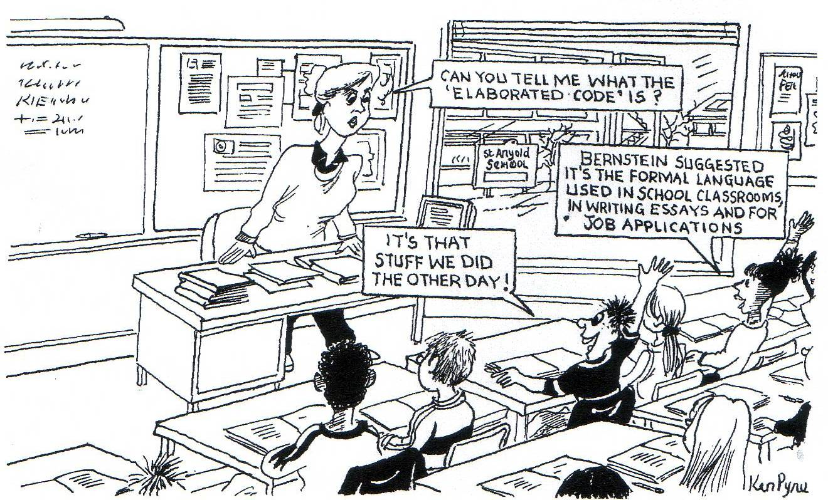
A theorist called Bernstein argued that the language codes, or the way they use speech, vocabulary and grammar, of middle class and working class children are responsible for their differential achievement.

Slide 10
While middle class speech is characterised by broader vocabulary, more detail and grammatically sound structure.
Watching this now, I can understand why people complained so much. It isn't just one or two attacks - it's incessant. I still can't figure out what I did wrong. This is so petty, so juvenile, so nasty. There is hatred there and that hurts deeply. I am someone who has never been judgmental, but Jade's behaviour is obnoxious, very aggressive, nasty and suffocating.
Because teachers are educated at a higher level and middle class, in the main, it’s like middle class children speak the same language and are therefore at an advantage. Educational success is judged largely on the quality of communication skills and this disadvantages working class kids who speak restricted code.

Slide 11
The restricted code, spoken mainly by working class children, lacks vocabulary, detail and grammatical structure…
*&^$$%$(*&**! I’m not a *&^$$£%$”** racist!!

Slide 12
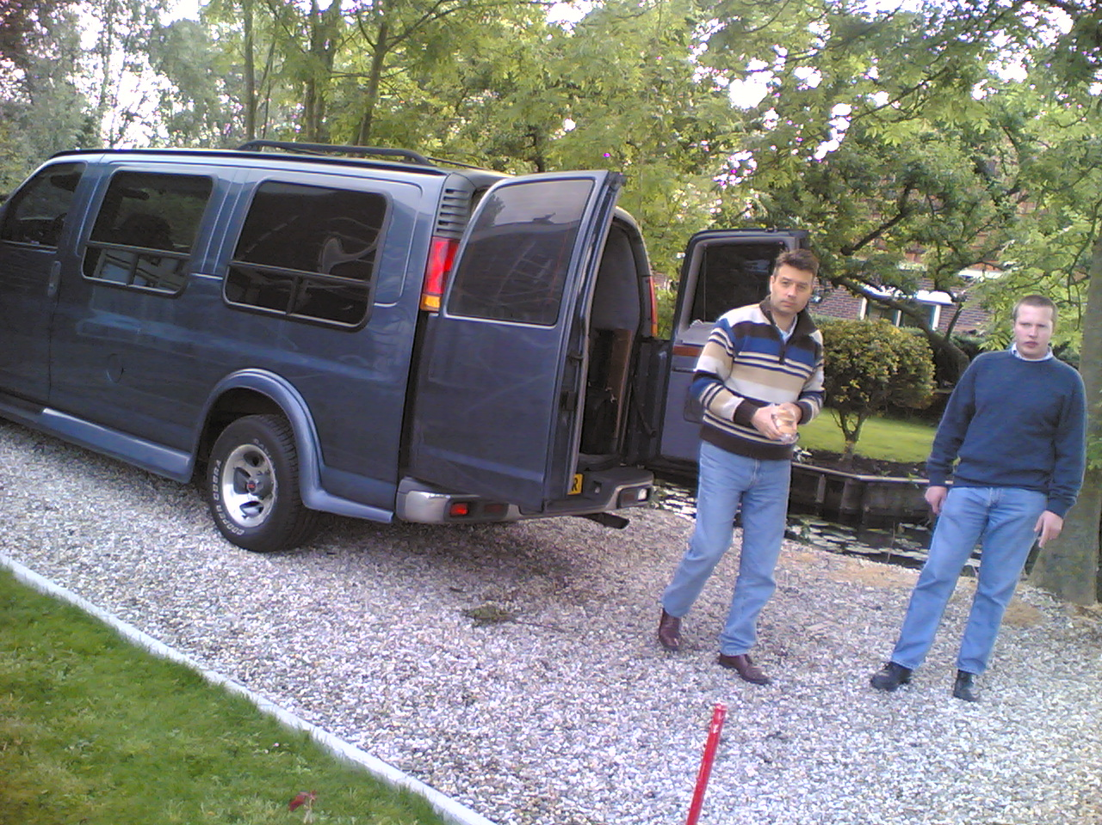
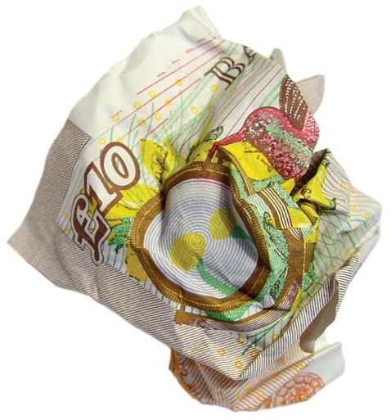
Working class kids are more likely to suffer from material deprivation which means that they lack the money to have the best chance of succeeding in education because they cannot afford the extras. Middle class kids’ parents can afford to move into catchment areas of ‘good’ schools, pay for their children to have private tuition, go on school trips, buy equipment, books etc.

Slide 13
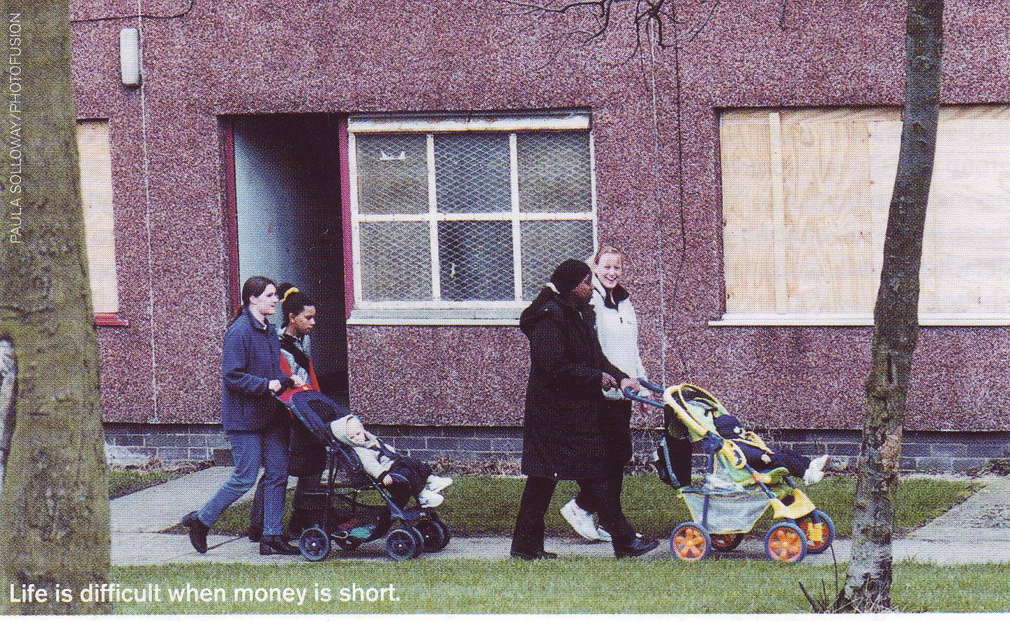
Working class kids, on the other hand, will have none of these privileges and are more likely to live in socially deprived areas with social problems, no facilities and over-crowded housing that gives them no space or peace in which to do school work.

Slide 14
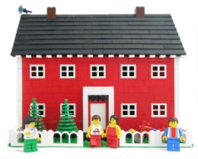
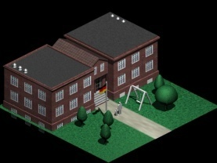
JWB Douglas
He wrote the home and the school. 1964.
JWB Douglas was interested in the effect of social class on educational attainment.
Longitudinal
Perspective
KEY CONCEPTS: Parental interest.

Slide 15
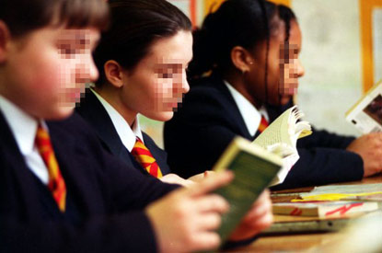
SUMMARY OF THEORY:
* He found that children from lower working class backgrounds were less likely to stay on at school while more affluent children were more likely to take their A levels.
School’s dull, we’re getting out as soon as we can.
I need A levels to be a gynaecologist.

Slide 16
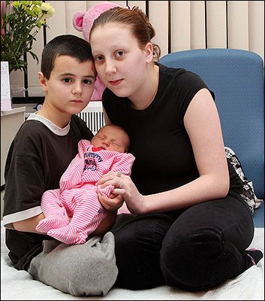
* He related educational success to student’s health, size of family and quality of the school. Poorer children are more likely to come from big families, attend poorer schools and to be less healthy.
I’m nearly as small as the baby.
Cos your mum has to shop at cheap places where they only sell rubbish food.

Slide 17
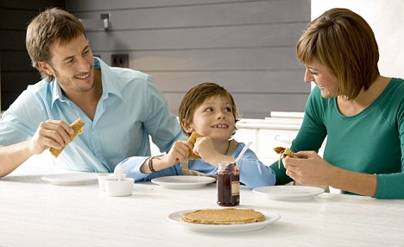
* Middle class parents were more likely to encourage their children to succeed and socialize them more effectively to achieve in education.
Let’s try that mock interview again.
Why do you want to be an accountant?

Slide 18
RESEARCH METHOD: Longitudinal study of 5,362 children born in the first week of March 1946, which continued until they were 16 in 1962. Participants were divided into groups in terms of their ability which was measured by IQ tests. They were sub-divided into four social class groups.
WEAKNESSES: IQ tests are unreliable, cultural capital misrepresents ability of working class children, high drop out rate common in longitudinal studies.

Slide 19
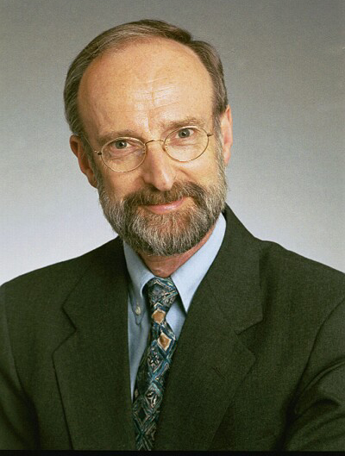
Barry Sugarman
He wrote social class, values and behaviour in schools. 1970.
Longitudinal
Perspective
Barry Sugarman took a sub-cultural approach to the study of the relationship between class and education.
KEY CONCEPTS: fatalism; immediate gratification; present-time orientation; deferred gratification; collectivism.

Slide 20
SUMMARY OF THEORY:
* Because middle class occupations provided more opportunity for advancement (promotion), such families had an attitude of deferred gratification. Their children were therefore socialized into these values and did better in school as they valued long-term goals.
My son knows it took four years at uni to become a doctor. He’s well motivated to achieve.
So I accept ploughing through school for seven years.

Slide 21
* Working class socialization emphasised present-time orientation and immediate gratification as their work did not allow the same opportunities for advancement.
We live to get our weekly wages. They’re not much but we just use them to get battered at the weekend.
So I’m not used to waiting for my rewards; school doesn’t keep me motivated.

Slide 22
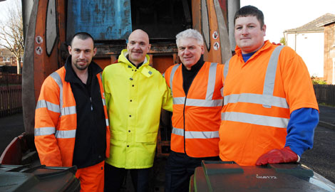
* Therefore working class children didn’t have the attitude to stick with education and wanted to earn money instead. They were more focused on collectivism (through parents’ Trade Union involvement), than individual achievement.
...than your own status.
The community’s more important...

Slide 23
RESEARCH METHODS: used interviews & questionnaires.
WEAKNESSES: social class differences in response to interviews & questionnaires may not reflect what happens in ‘real life’.

Slide 24
Basil Bernstein
He wrote social class & linguistic development. 1961.
Perspective
He used an experimental approach to make links between language and educational achievement.
KEY CONCEPTS: elaborated code; restricted code.

Slide 25
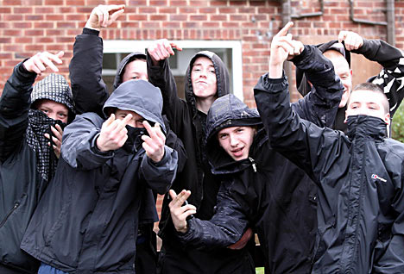
SUMMARY OF THEORY:
* He found that working class children tended to speak in a restricted code which had limited expression and implicit (implied, not quite clear) meaning. It also had limited grammatical complexity, vocabulary & are a kind of short-hand speech.
&^$£%*% &^&$ %$”” !!!!

Slide 26
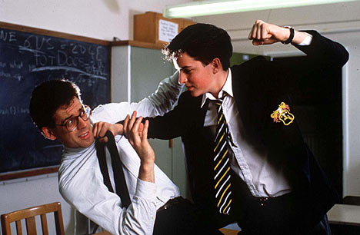
* Middle class children tended to use the elaborated code is more detailed and the meanings are more clear through the use of more specific vocabulary.
I’m compelled to rain blows down on you Sir, because you’ve really irked me.

Slide 27
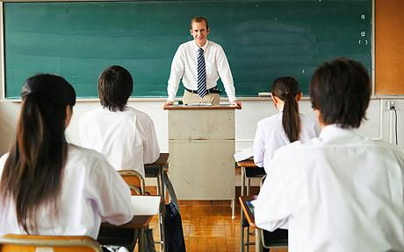
* Because education relies on an elaborated code as its common mode of communication, working class children are disadvantaged in terms of their understanding & expression.
If you’re of a lower socio-economic status, you may find this lesson challenging.
Splendid, I find it infinitely preferable to be in close proximity to fellow scholars instead of ruffians.
You what? I’m outta here.

Slide 28
* Middle class jobs tend to demand the use of more elaborated codes while working class jobs, often manual, do not rely on verbal expression or complex language.
As a lawyer, I do talk about my work at home with my family and my children have picked up a lot of legal terminology.
Cut and blow?

Slide 29
RESEARCH METHOD: one method was when he used two 5 year old boys to explain a series of four pictures.
WEAKNESSES: the method is hardly representative. Rosen argues Bernstein has a very simplistic approach to class. There is little sound evidence for his claims.

Slide 30
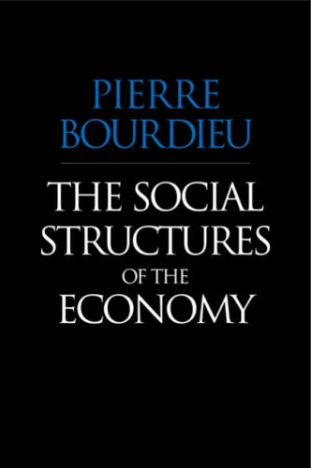
Pierre Bourdieu
He wrote the school as a conservative force. 1974.
He had a Marxist perspective towards the education system and saw it as an agent of social control for the benefit of capitalism.
Perspective
KEY CONCEPTS: cultural capital; cultural reproduction.

Slide 31
SUMMARY OF THEORY:
* Bourdieu argued that working class failure is the fault of the education system and not working class culture.
No: you’re failing my son because he’s working class and doesn’t have the same attitudes and ways as you, you middle class idiot!!
Your son just doesn’t behave & doesn’t value what we’re trying to each here.

Slide 32
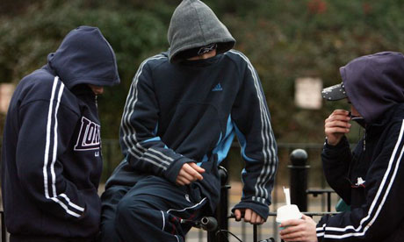
* The education system is biased towards the culture of the dominant social classes and devalues the knowledge and skills of the working class.
What’s the point of learning about classical civilization when I want to be a mechanic?

Slide 33
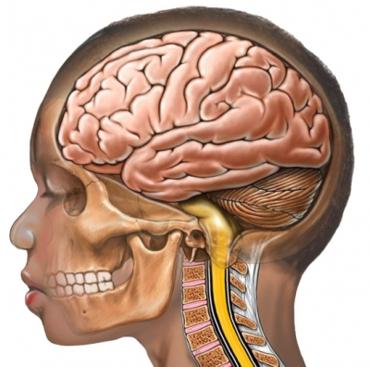
* The possession of the dominant culture by an individual is referred to as cultural capital because, via the education system, this can be translated into wealth and power.
(Success in education = superior qualifications = professional and powerful occupations/careers).
trigonometry
Shakespeare
poetry

Slide 34
RESEARCH METHOD: the theory of cultural capital was developed on a theoretical, therefore non-empirical basis, by Bourdieu and his colleagues at the Centre for European Sociology in Paris.
WEAKNESSES: this theory does not have any empirical basis as Bourdieu’s work was purely theoretical.

Slide 35
Diane Reay
Class Work; Mothers’ Involvement in Their Children's’ Primary Schooling. (1998).
Perspective
Reay used the concept of ‘cultural capital’ in the more practical setting of primary education.
KEY CONCEPTS: cultural capital; material capital.

Slide 36
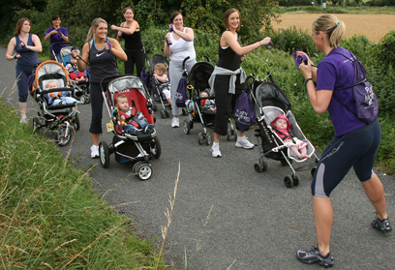
SUMMARY OF THEORY:
* Reay found that “it is mothers who are making cultural capital work for their children”. She found that the amount of cultural capital possessed by middle class mothers meant that their children succeeded more in education that their working class peers. Reay ascribes this to cultural capital.
OK ladies!! Drill your kids in books, plays & extra tuition!!!!

Slide 37
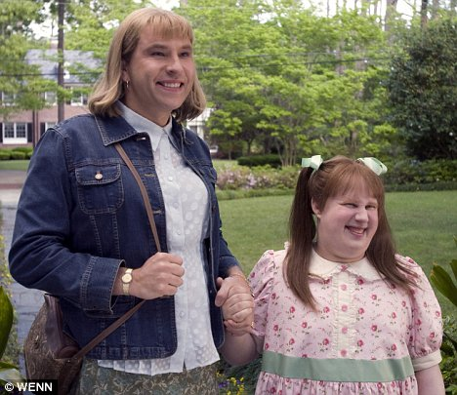
* Middle class mothers had the knowledge and skills to help their children more effectively with homework and to challenge the school and negotiate with teachers for the benefit of their children.
What do you mean Flatulence only got a B? I wrote that myself!
My mummy’s going to get you sacked, Miss.

Slide 38
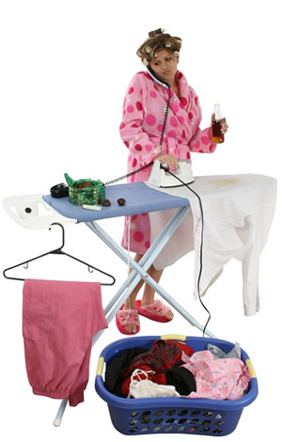
* Middle class mothers could afford to have domestic help (giving them more time for their children) and pay for private tutors.
No mate, I’m running this woman’s life so she can dedicate herself to turning her kids into dentists.

Slide 39
RESEARCH METHOD: Reay interviewed mothers of 33 children at two primary schools in London.
STRENGTHS: Provides the empirical support for Bourdieu’s cultural capital theory.
WEAKNESSES: Based on a London sample of the mothers of a relatively small group; not representative of whole population.

Slide 40
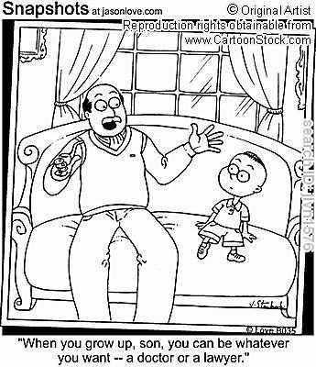
Ball, Bowe & Gerwitz
Competitive advantage & parental choice. 1994.
They examined the effects of parental choice and competition between schools on the education system and opportunities for students from different social groups.
“When you grow up, son, you can be whatever you want – a lawyer or a doctor.”
KEY CONCEPTS: privileged/skilled choosers, semi-skilled choosers, disconnected choosers.

Slide 41
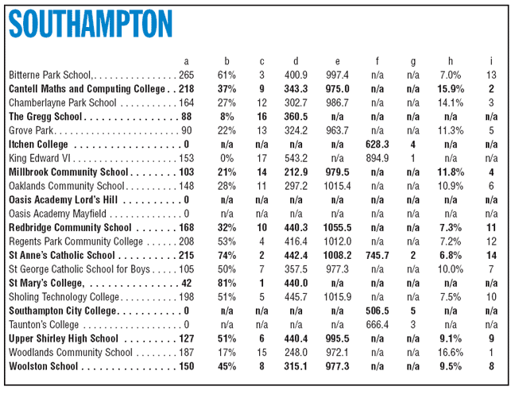
FINDINGS OF STUDY:
* The use of school league tables, open enrolment & formula funding (bums on seats) had a number of consequences for education. This was because schools wanted to attract and select more ‘able’ students to boost their place on the table and their reputation.

Slide 42
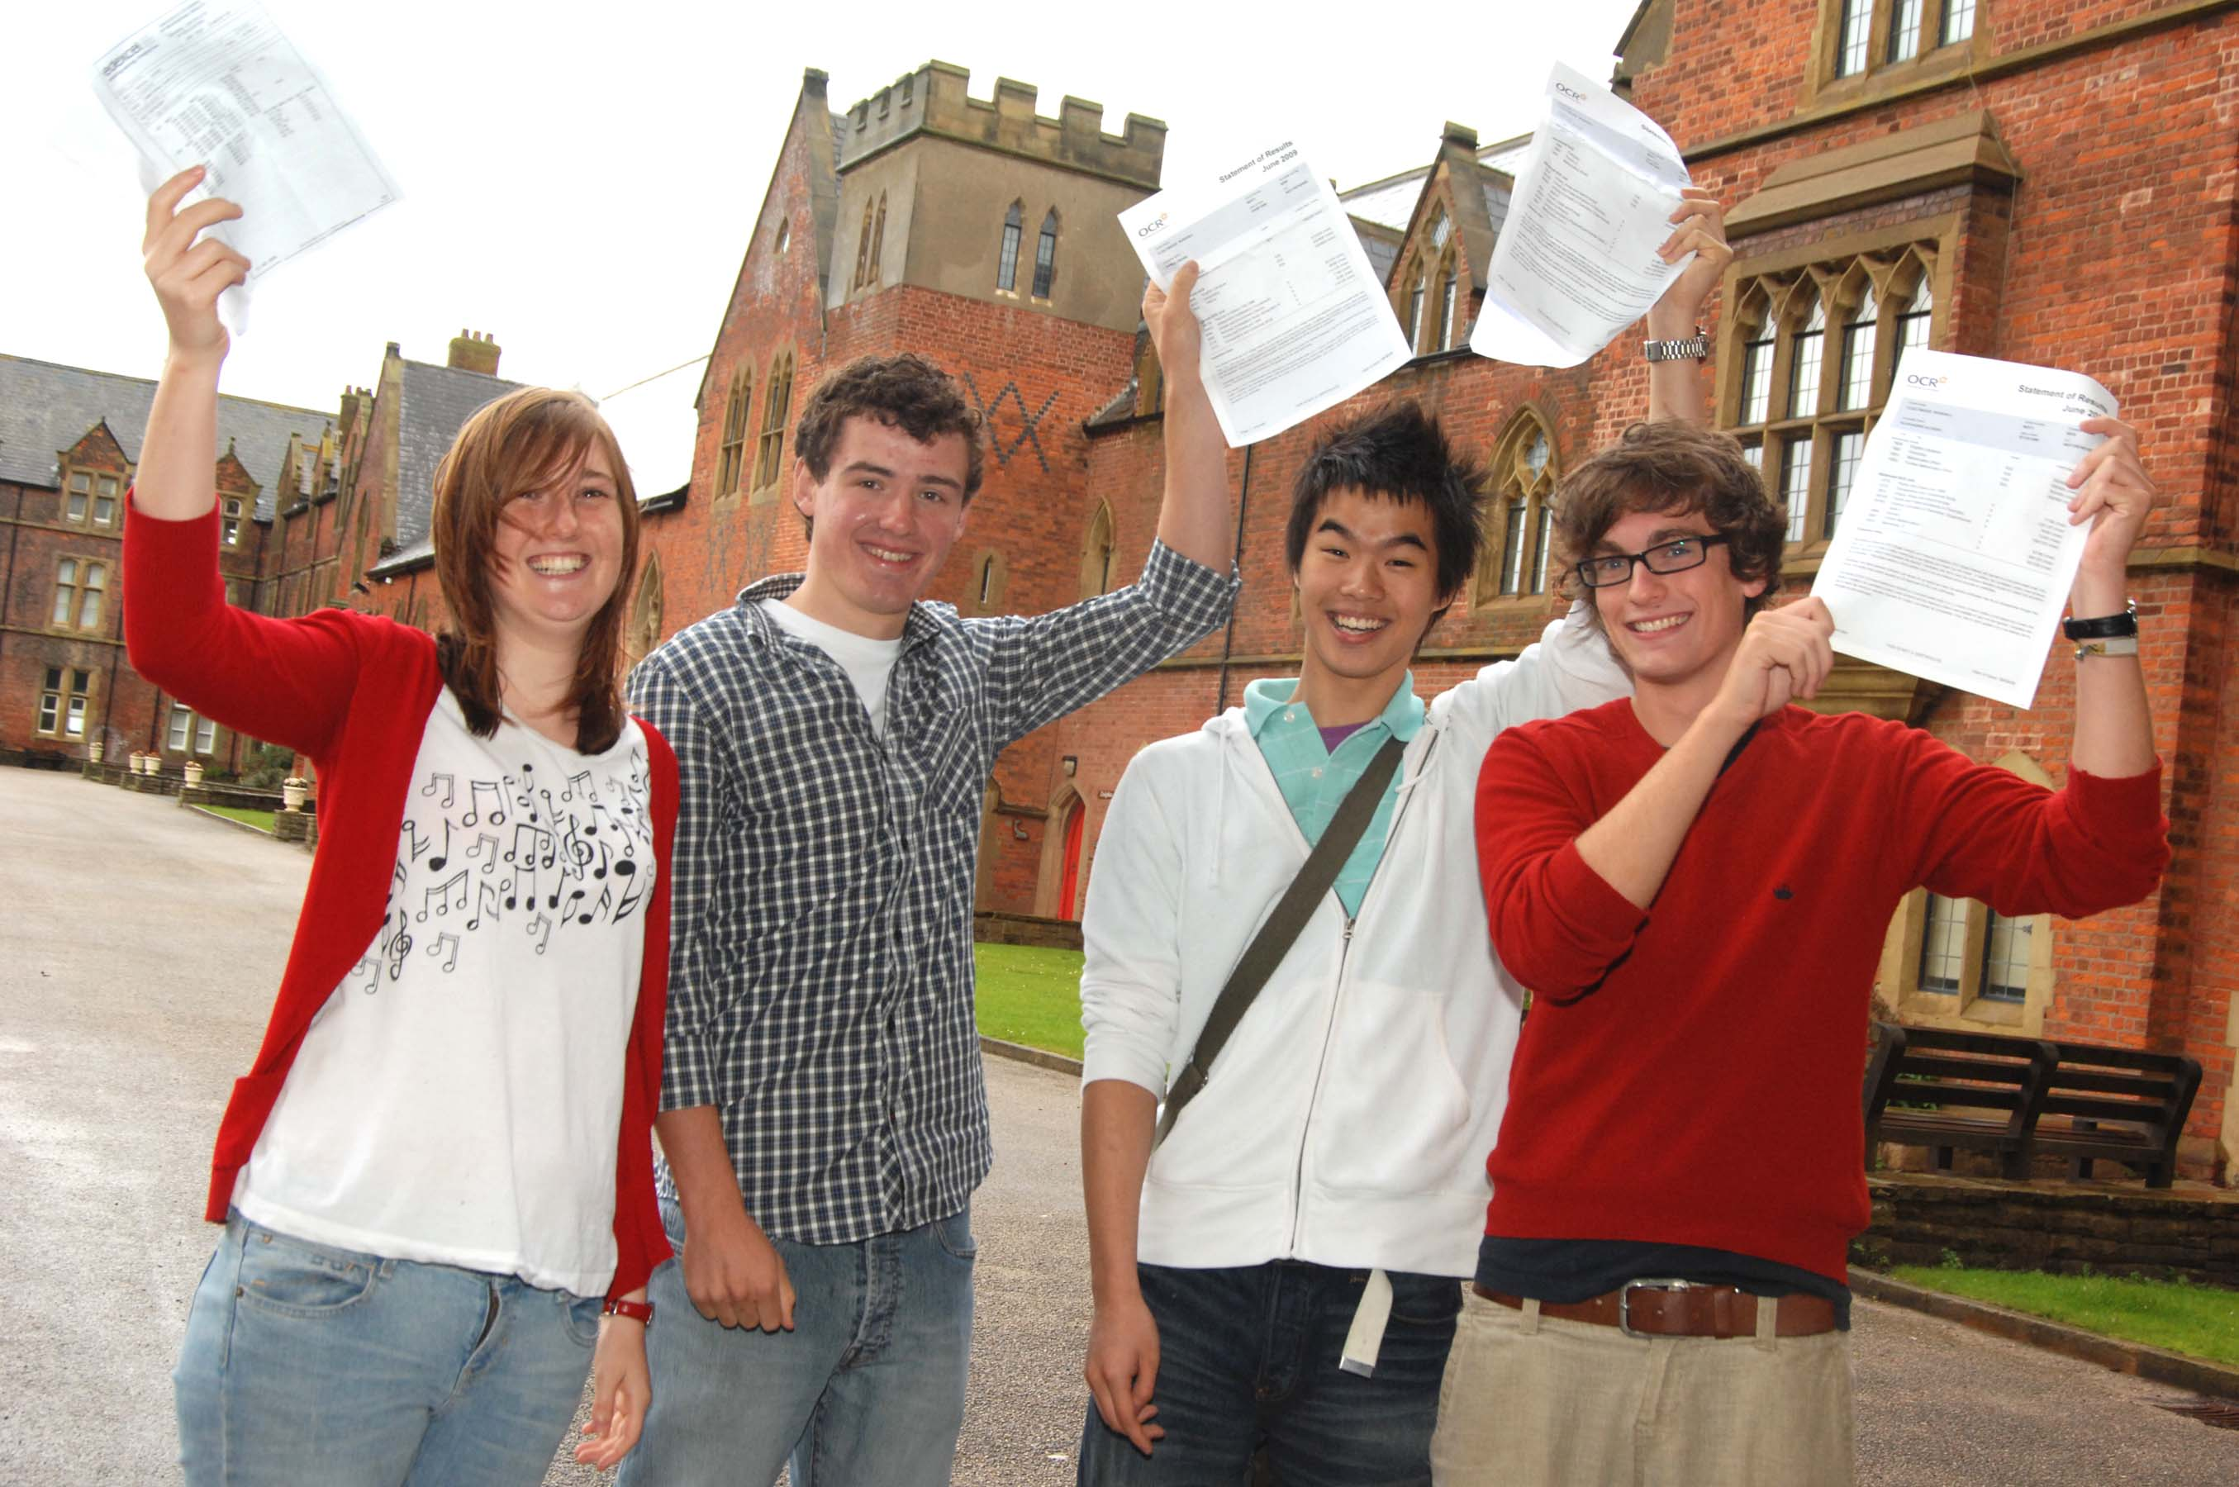
“There is a shift of emphasis from student needs to student performance,
from what the school can do for the students to what the students can do for the school.”
Our school only let me in to make them look good.

Slide 43
There’s been a shift in values from comprehensive and social justice to market values, money and reputation. There was also suspicion and hostility between schools now.

Slide 44
They examined parental choice and found that it was limited by availability of schools and ability of parents (in terms of their motivation and money).

Slide 45
Found three types of parents when it came to choosing schools:
i) Privileged/skilled choosers – had strong motivation and skills to fight for the ‘best’ school, had money to move to catchment area or pay for private school. More than likely to be middle class with university education.
My son needs a school that will nourish his artistic flair, give him the opportunity to work towards his goal of becoming an occupational therapist and be sensitive to his dyslexia. So we’re moving to get him into the best school.

Slide 46
ii) Semi-skilled choosers – strong motivation but little ability to ‘engage with the market’. Lack social contacts & cultural skills to fight for the best choice. Less likely to appeal if their children are rejected from their first choice. More thank likely to be working class and to choose local school.
I want my boy to go to the best school but it’s out of our catchment area. We just can’t afford to move and I’m terrified about appealing. I don’t know what to do or who to approach.

Slide 47
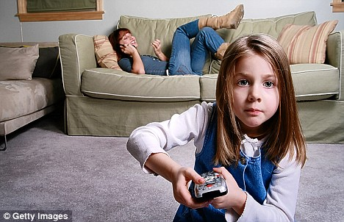
iii) Disconnected choosers – not involved & don’t see it as important, more than likely to choose the nearest school. More concerned with their children’s happiness than their academic performance. More likely to be working and underclass.
No, don’t worry about it. Send her with mine, they’ve been mates for years, it would upset them to split them up.

Slide 48
RESEARCH METHOD: conducted surveys of 15 schools in 3 neighbouring Local Education Authorities (LEAs).
Mix of LEA controlled schools, grant maintained schools, two church schools & a City Technology College.
There was a mix of middle and working class schools and areas of high to no ethnic variety.
Attended meetings, interviewed head teachers, parents and teachers.
Examined a variety of documents about patterns of choice.

Slide 49
Key concepts in social class and educational achievement.
1. Material deprivation
2. Cultural deprivation
3. Social deprivation / exclusion
4. Social class subcultures
5. Restricted code
6. Elaborated code
7. Dominant culture
8. Cultural capital
9. Social capital
10. Fatalism
11. Immediate gratification
12. Present-time orientation
13. Collectivism
14. Particularistic meanings
15. Universalistic meanings
16. Compensatory education
17. Education Action Zones
18. Cultural reproduction
19. Habitus
20. Elimination
21. Poverty penalty
22. Parental interest
23. Skilled choosers
24. Semi-skilled choosers
25. Unskilled choosers

Slide 50
Using every single one of the concepts we’ve put on concept cards, write a story, as creatively as you can, on the educational lives of the following types of students:
A boy with a working class background, in year 11.
A girl from a middle class background, in year 9.
A boy from an upper class background, in year 7.
A girl from an underclass background, in year 8.
You’re allowed to word process this!
Include images to illustrate these concepts.
Suggested formats:
A photo story;
A script for Waterloo Road;
A short story;
A teacher’s report.

