Slide 1
Milgram’s Study of Obedience (1963)
OBEDIENCE-
a change in behaviour as a response to a direct order from an authority figure.

Slide 2
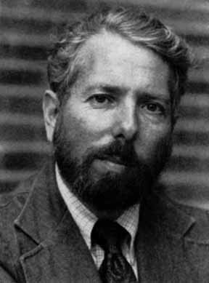
Aim
To investigate how far people will go in obeying an authority figure.
“Germans are different”

Slide 3
Procedure
Laboratory Experiment.
40 males between the ages of 20-50 were recruited via a newspaper advert (self-selected sample)
They were told they were taking part in a teaching and learning experiment.
All the participants were allocated the role of teacher. The learner was a confederate ‘Mr Wallace’.
The experimenter was dressed in a grey lab coat.
The learner was strapped into an ‘electric chair’ in the next room. The teacher was given a sample shock, to show what it felt like.
Every time the learner made an error the teacher had to give progressively more intense electric shocks 14 volts -450volts.
If the learner hesitated, he was given verbal prods by the experimenter, such as “You have no other choice, you must go on.”
The experiment finished when the participant refused to go on.

Slide 4
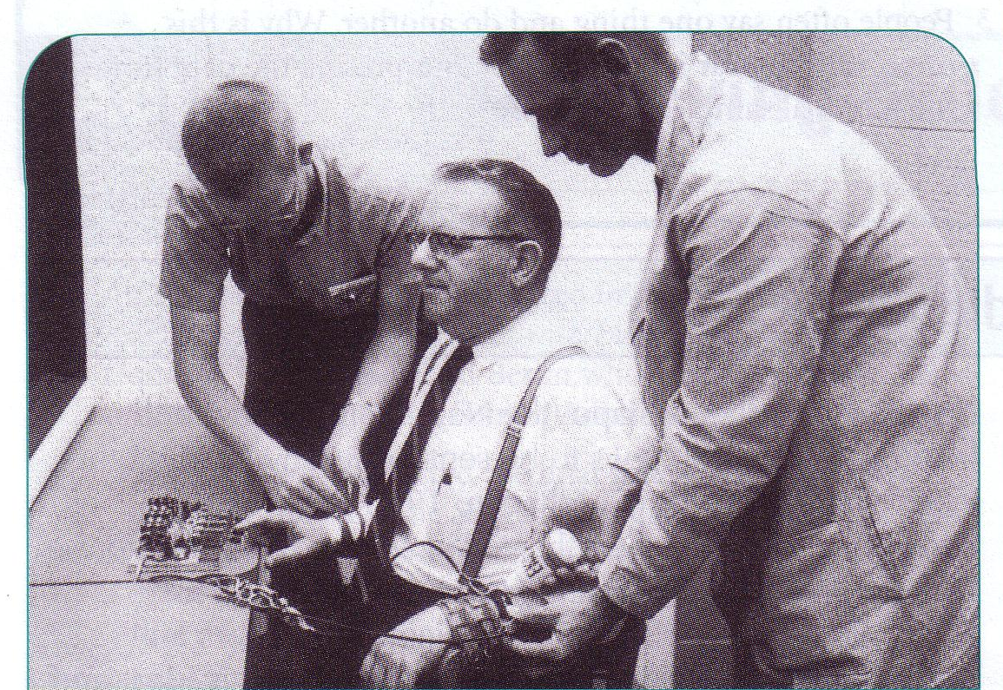
Findings
Despite the protests of the learner, all participants went to 300 volts (intense shock)
65% went to 450 volts (XXX)

Slide 5

Conclusions
Most people will obey an authority figure without question.
Socialisation – We are taught from an early age to do as we are told.
Agentic State – People abdicate responsibility by blaming the person who gave the order. “If wasn’t my fault, I was only following orders!”

Slide 6
Criticisms
Strengths
Showed how easily people obey without question .
Replicable design
Control of variables
Classic study
Real world applications
Weaknesses
Lacks ecological validity
Lacks experimental validity
Ethics!!

