Slide 1
Post Modern Youth
A look a post-modernist perspective and its views on youth sub-culture.
Starter Question:- How is contemporary youth culture different today from cultures in the 50s .60s and 70s?

Slide 2
Theoretical re-cap
Structural theories are Macro – they consider the big structures which determine how society works – social class, gender, functions of institutions like marriage or justice system.
Social Action theories are Micro – they consider the interactions between people, how people are labelled by others
Post Modernism does not fit into either of these because they believe that society is different now!

Slide 3
Post-modernism re-cap
It is not possible to have an overriding theory of society things are too fluid and diverse.
We live in a media saturated society which makes it difficult to see what reality really is.
We can make choices about our identity and we can buy identities through consumerism.
We can move in and out of identities as it suits us.
Evaluation – is this true?

Slide 4
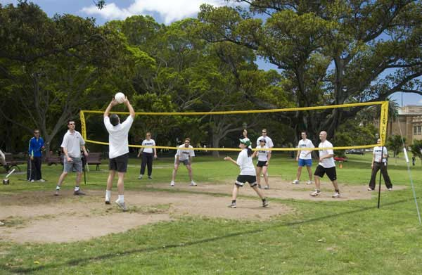
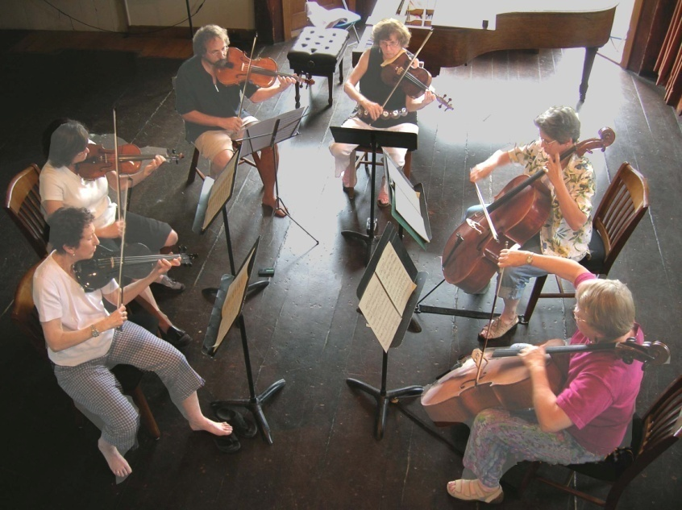
List Leisure activities you have taken part in, what specialist knowledge do you need?

Slide 5
Youth is all about style
Who has style and who doesn’t
Describe them !!
Is youth culture more style less substance? Post modernism says youth today lack any political concerns, they only care about consumerism and leisure! Is that true?

Slide 6
Post-Modernism and Youth
Post modernists argue that since the 1990s youth style and culture has become increasingly diverse and fragmented.
They argue that sub-cultures no longer necessarily form around commonalities like gender, class or ethnicity and that styles based around particular music or clothing tastes have broken down.
Kellner – Young people increasing express identities through purchases
However this may still be class based, for example Archer researched how middle class youth expressed privilege through buying designer goods. See p. 156

Slide 7
Tribalisation
Refers to the breaking down of associations based on gender, ethnicity or class and the recomposition of associations based on ‘tribal’ identities which are mainly consumer and leisure orientated.
– it is less a question of belonging to a gang, a family or a community than of switching from one group to another. Maffesoli (1996)

Slide 8
NEO Tribes
This is what Bennett (1999) called a Neo Tribe.
Youth is a social construction and in recent years has become elongated.
Young people therefore may pick and choose their associations due to a need to find satisfying leisure activities.
They are not identities that are fixed or rooted in particular gender,class etc they are loose associations which can change.
Examples ………………..

Slide 9
Club Culture
Clubbers in the late 80’s and early 90’s based on collective experience of dance not based on any particular class, gender etc.
Researched by the MIPC – Manchester Institute of Popular Culture.
Mosh Pits embrace everyone of every identity!!
Post Modernists believe that we can move in and out of this type of culture. E.g clubber at the weekend, sensible bank clerk during the week.

Slide 10
The Supermarket of STyle
Polemus (1997) develops the idea of fluidity of youth styles.
The dazzling choice often means that styles are fused together to create new styles e.g
Britney uses Bhangara beats in her music.
More examples Hippie bracelets etc worn with skinny jeans, ………………..
This means that youth culture is more about style and it is not about shared identities such as class etc and therefore is a critique of CCCS.

Slide 11
Youth and post modern media
Interactionists like Stan Cohen argued that the media demonise youth through moral panics, however….
Boyd (2010) Young people are increasingly able to create their own media and ignore mass media for example through social media, youtube, fb, blogs, apps, games etc
AO3 point Maybe this means that adult run corporations and media outlets will have less control over youth culture, although Buckingham (2010) argues that youth are becoming ever more important to big business such as Nike, Starbucks etc see p.157

Slide 12
Task
Work you way through the questions on the worksheet at your own pace and ask for help if you need it.
Extension task read

Slide 13
Criticisms
In what ways can we criticise post modernist perspective on youth culture?see p. 195
Use the other perspectives to form a comparison e.g
Marxists believe youth culture is mostly about class differences and resistance whereas post modernism…………………………………….

Slide 14
Key terms check looking back !
Rite of passage
Crisis of Identity
Magical solution
Resistance to capitalism
The CCCS
Diverse and fragmented identity
The MIPC
Tribalisation
Neo-Tribes
Risk Society.

