Slide 1
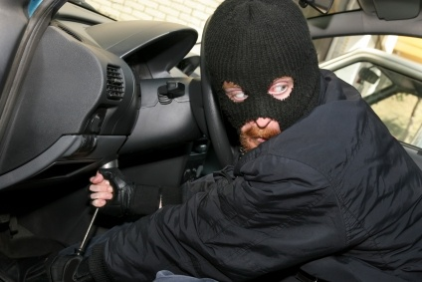
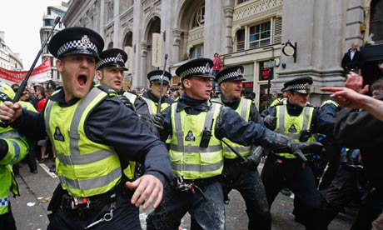
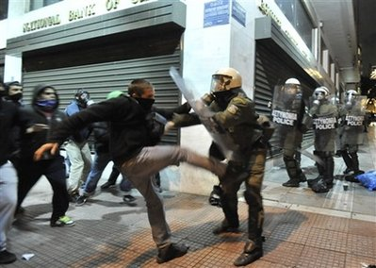
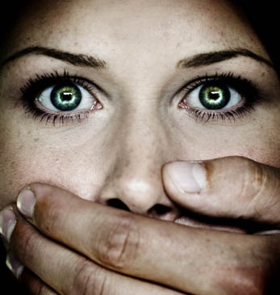
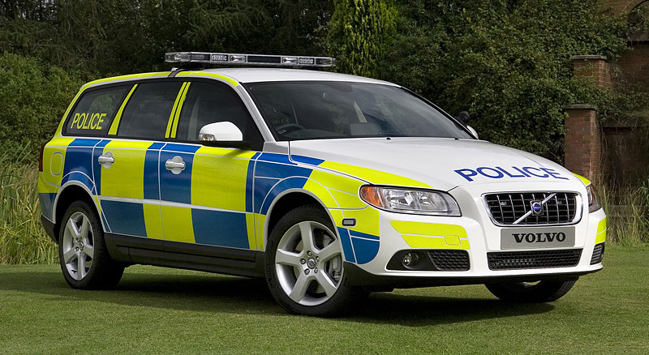
SY3 -Understanding Power and Control
Understanding Crime
Mrs Leigh Ashford

Slide 2
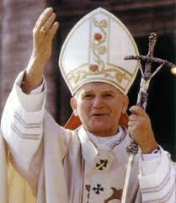
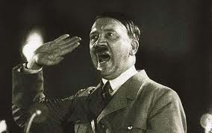
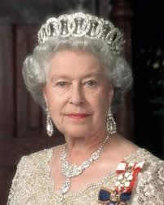
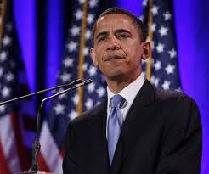
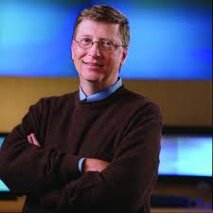
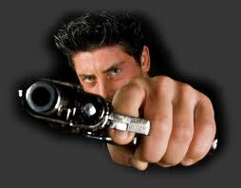
WHAT IS POWER?
“an individual or group has power when they are able to get what they want despite opposition from other people”

Slide 3
Sources of power
Coercion which involves the use of force. People obey because they feel that they have no choice and that they are forced to obey against their will.
Authority is exercised over us when we willingly obey an individual or a group because we see it as the right thing to do. Force is not necessary because we agree to obey.

Slide 4
Which types of authority do these people have?
Which have power based on coercion and which from authority?
Headteacher
A mugger
Prime Minister
Police officers
Bullies
Parents

Slide 5
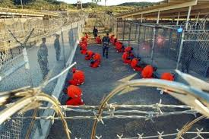
State crimes are committed by, or on behalf of states and governments in order to further their policies
Genocide
War crimes
Torture
Imprisonment without trial
Assassination

Slide 6
McLaughlin – 4 categories of state crime
Political crimes – corruption/censorship
Crimes by security/police forces – genocide,
torture, disappearance of dissidents
Economic crimes – official violations of health &
safety laws
4. Social & Cultural crimes – institutional racism

Slide 7
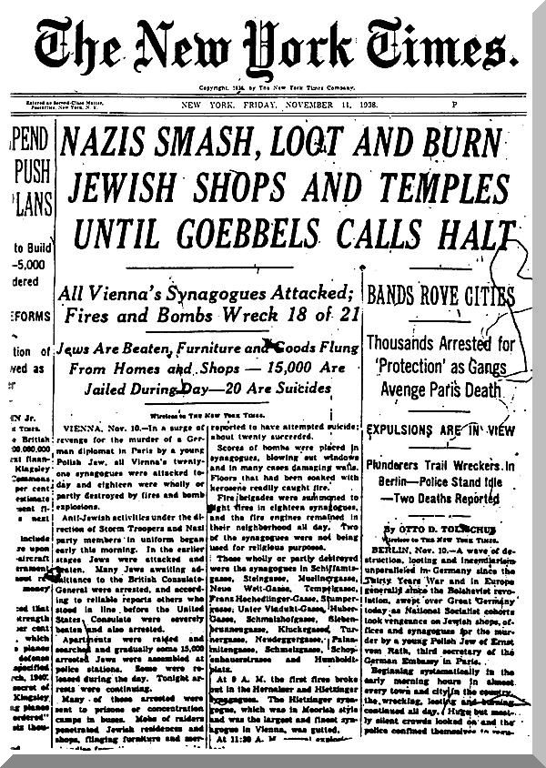
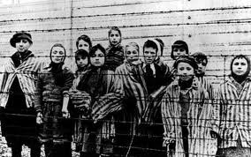
Nazi Germany

Slide 8
Kelman & Hamilton (1989) – features that produce crimes of obedience
Authorisation – this is when acts are ordered or approved of by those in higher authority. This is where moral principals are replaced by a duty to obey.
Routinisation – the crime becomes routine – a common practice that can be done in a clinical, detached manner.
Dehumanisation – this is where the ‘enemy of the state’ is portrayed as sub-human. Not to be treated as normal! Here the usual principles of morality do not apply.

Slide 9
It can happen anywhere
The Germans are not different – Milgram
8 Stages of genocide
Germany
Rwanda
Sudan, Darfur
Yugoslavia Kosovo
http://www.youtube.com/watch?v=BcvSNg0HZwk

Slide 10
Examples of Genocide
Rwanda 1993 - slaughter of Tutsies by Hutus (Belgians created these differences when they were in power – Divide and Rule)
Darfur – 2003 Janaweed Militias ethnic cleansing of non-arab population.
Iraq 1980s– mass killing of Kurdish people using chemical weapons – ‘justified by Quran
Kosovo 1998– Mass killing of Muslims by Serbian law enforcement and forces.

Slide 11
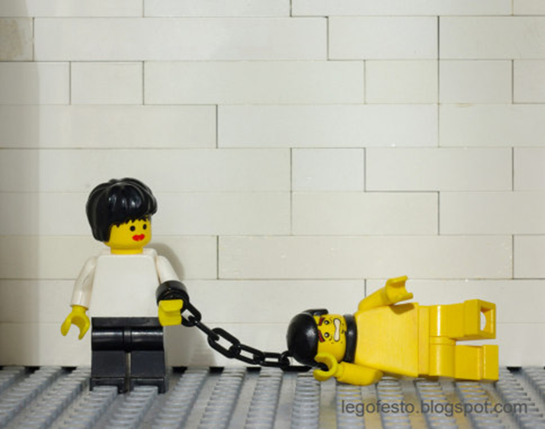
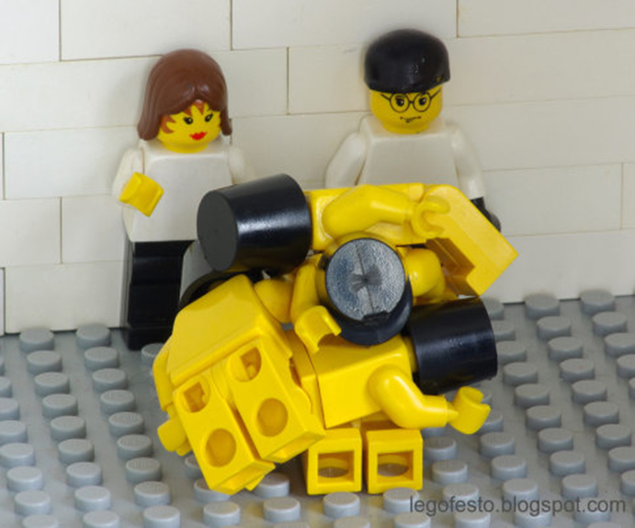
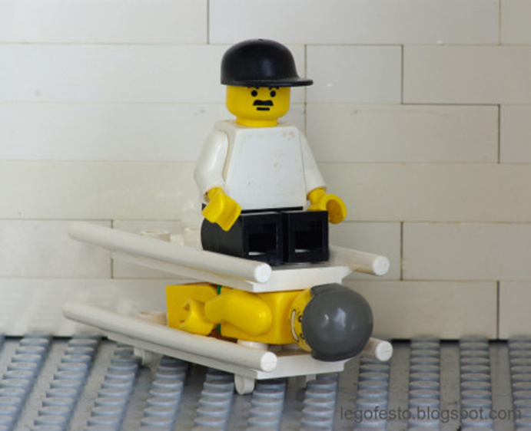
US forces in Iraq

Slide 12
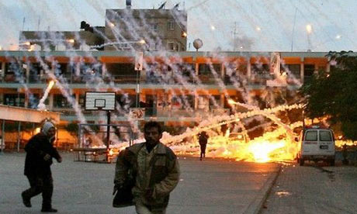
Israel – Gaza Strip

Slide 13
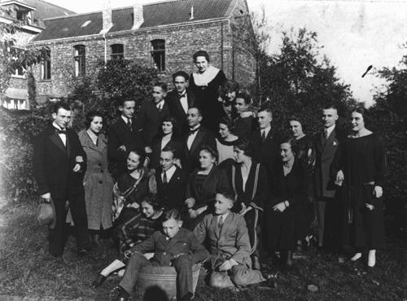
1. People are put into different categories according to their differences.

Slide 14
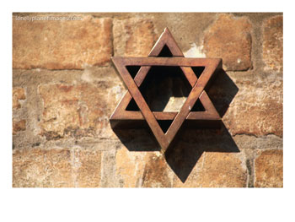
2. The categories are given names such as Jew or Aryan (Pure German Blooded).

Slide 15
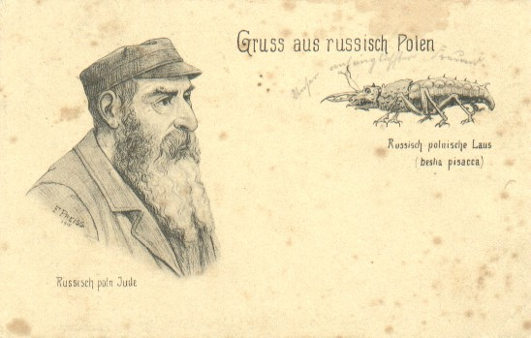
3. One group of people begin to treat another group as if they are not human. Everyone is encouraged to hate the group .

Slide 16
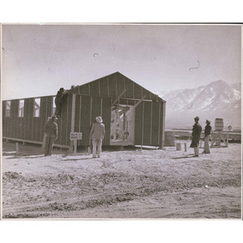
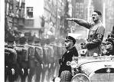
4. Organised governments or groups begin to plan how to get rid of the hated group.

Slide 17
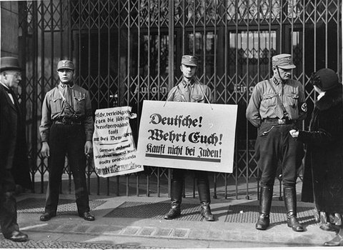
5. The hated group is kept apart from others. Laws are made to prevent socialising or marriage between groups.

Slide 18
6. The hated group is forced to wear symbols or certain clothing which marks them out. Their property is confiscated and they are then forced into ghettos (camps).

Slide 20
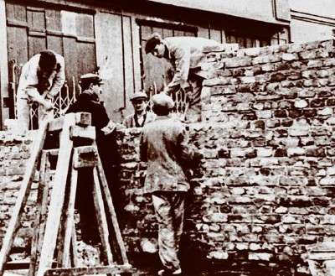
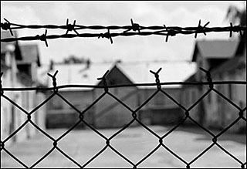
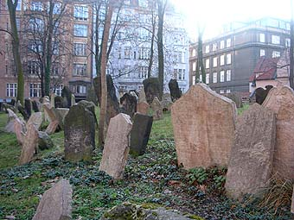

Slide 21
7. The mass killing of the people in ghettos and camps begins to take place. 6

Slide 22
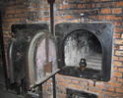
8. People try to deny what happened and try to hide the evidence.

Slide 23
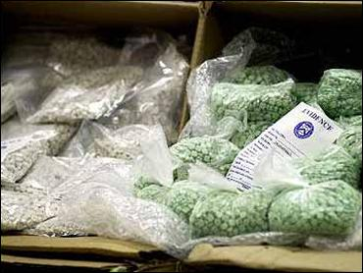
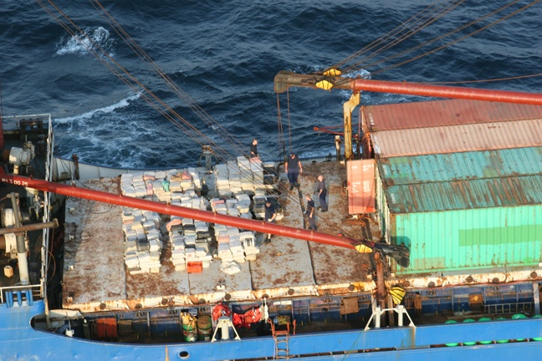
Globalisation- supply and demand
Part of the reason for transnational crime is the economy of demand and supply.
The rich west demands products eg. drugs, sex workers.
The poor third world countries supply these services.
For example in Columbia 20% of the population is dependent on the cocaine trade for their livelihood.

Slide 24
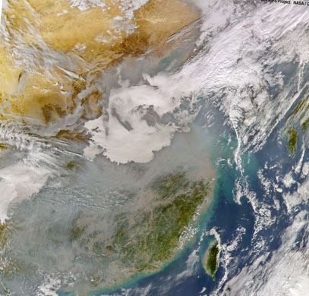
Green crime
This can be defined as crime against the environment.
Regardless of the creation of nation states the Earth is in fact a single connected eco-system.
Atmospheric pollution in one country turns to acid rain in another country.

Slide 25
Green criminology
Many of the problems created by technological advances such as global warming are not the result of criminal activity, as such.
Traditional criminology has only been interested in law breaking activity. It is criticised for accepting the definitions of crime shaped by big business and power elites.

Slide 26
Green criminology
GC takes a more radical approach.
It starts from the notion of harm rather than law.
White (2008) argues that if harm is done to the environment or human/non-human animals that this should be the subject of green criminology regardless of it’s legal status.

Slide 27
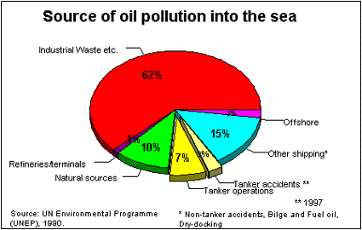

Slide 28
Plenary questions
What is the difference between coercion and authority?
Can you name two categories of state crime?
How is authority used to explain state crime like the holocaust?
Why do you think the cocaine business is so rife in Columbia?
What is the issue with Nation States and green crime?
http://www.youtube.com/watch?v=ojuNohlWcng
http://www.youtube.com/watch?v=cSzVfda6AGE

