Slide 1
shortcutstv
presents

Slide 3
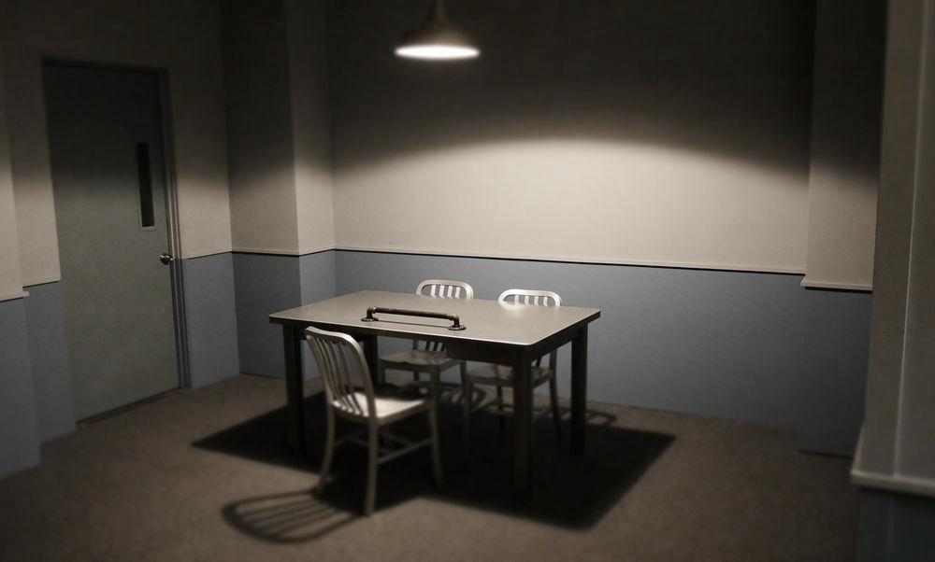
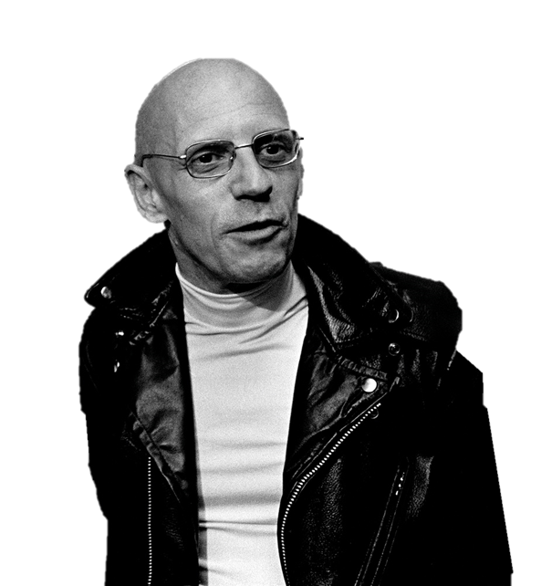
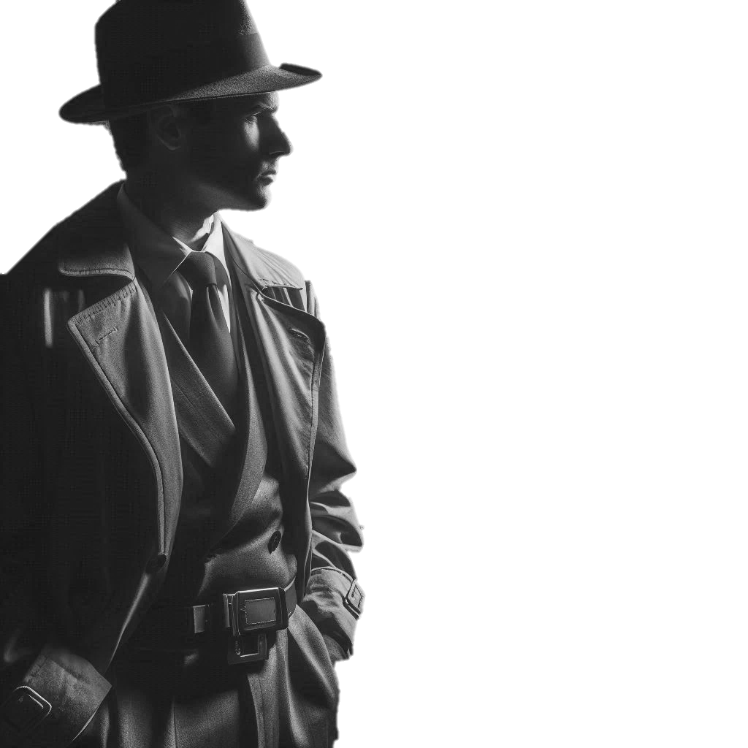
Investigating
Sociology

Slide 4
Investigating
Sociology
Someone clever once told me that “even the longest journey starts with a first step”.
To which I replied “But if you don’t know where you’re going, what’s the point?”.
(They had to admit I was maybe right on that one).
So where are we going?

Slide 5
Investigating
Sociology
When you’ve walked these mean streets as often as me, experience tells you the best place to start is at the beginning.
And the first step to take is to understand what you’re studying.
A wise man once said that.
But enough about me. Let’s get this party started…

Slide 6
George Ritzer (1940 - )
American academic.
aka
“Big Mac”*
*For reasons that may or may not become clear later.
Much later.
Probably.

Slide 7
Investigating
George Ritzer
Sociology
This is a stripped-down version of Ritzer’s definition that serves to set the scene for later ideas about Sociology’s object of study.
The basic idea is to encourage students to start to express their ideas about how our membership of very basic social groups - from families to friends - influences our behaviour as individuals.
The main objective is to initially orientate your students towards the idea of social influences and this simple discussion-piece is a way to not only do this but to also get them talking about their own social experiences and those of the people around them.
If things are slow to start - as they can be with students who are unlikely to know each other very well - you might want to prepare some observations (how do they know how to be sons, daughters, friends, students…) to get things moving…
Talking Points
“Sociology is the study of individuals in a social setting.”
How do the groups - family, school, friendship, peer and more - to which we belong shape our thoughts and actions?

Slide 8
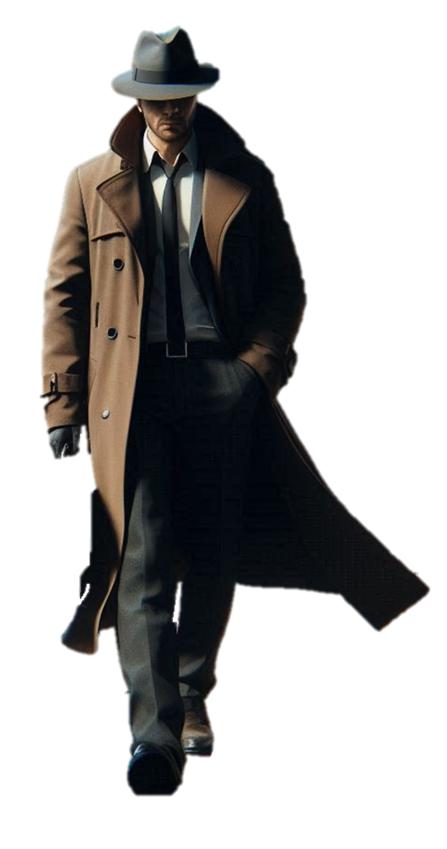
Investigating
Your answers to the previous question should tell you something about what Sociology is:
On screens such as this, where you need to do something in order to leave (click something or, as in this case, move your mouse pointer to the edge of the screen) the direction travelled by the detective will indicate the direction you need to move your pointer.
In this instance the detective leaves at the bottom of the screen so moving your pointer to the bottom edge will move the Presentation to the next screen.
Sociology
The study of the social forces that shape individual thoughts and actions.
So this is where we place our investigative focus.
Although there could be a problem…

Slide 9
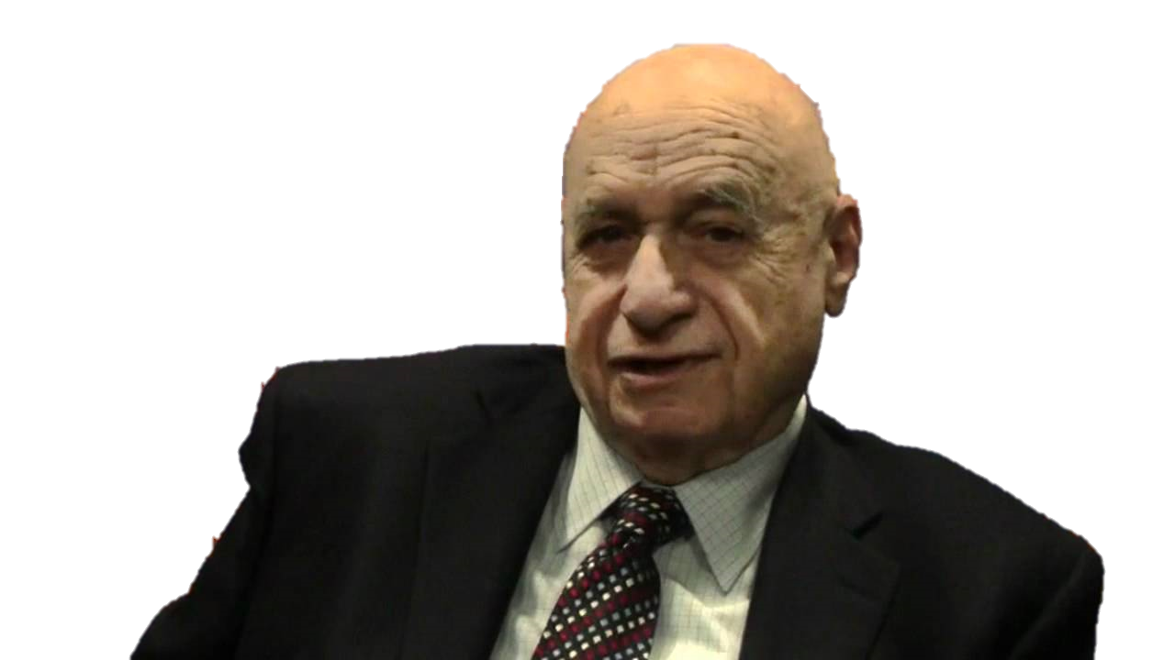
Peter Berger (1929 - 2017)
Invitation to Sociology
“The first wisdom of sociology is this:
Things are never what they seem.”

Slide 10
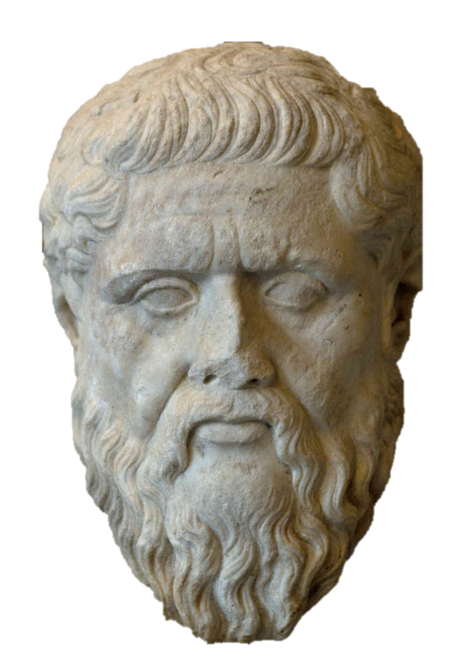
Investigating
On some screens such as this, where the detective moves into the middle distance, clicking the area they disappear from will move you to the next screen.
In case anyone should ask, the mask that appears at the top of the screen, before being dismissed by the detective, is that of Pheadrus. He seems to be the original source for the Berger quote.
Sociology
For the sociologist, the world isn’t “given” to us by external forces like “god” or internal forces such as “instinct”.
It is socially constructed.
And your job is to discover how.
And maybe also why.
(But’s that’s optional for now).
“Things are never what they seem…”.

Slide 11
Peter Berger
Investigating
On a few screens, this being one, nothing happens until you click something. In this instance the paint can which then paints the wall…
Sociology
“The fascination of sociology lies in the fact that its perspective makes us see in a new light the very world in which we have lived all of our lives”.

Slide 12
Investigating
What norms exist in your classroom?
Sociology
What happens if you break them?

Slide 13
Investigating
Aside from learning about norms, one outcome of that last exercise is the observation that life has rules.
This screen starts a short sequence that touches on the idea of research methods by suggesting sociological knowledge is superior to something like commonsense knowledge because an attempt is made to collect and test data systematically.
This gives you an opportunity to talk about things like the research process, different research methods and the like if that’s something you want to introduce at this point.
Sociology
But questions about who makes them?, why? and, a personal favourite, who benefits from them? are the kind sociologists are good at asking.
Although it’s not just a case of “looking and learning” in a haphazard way.
The sociological detective is a lot more organised than that…

Slide 14
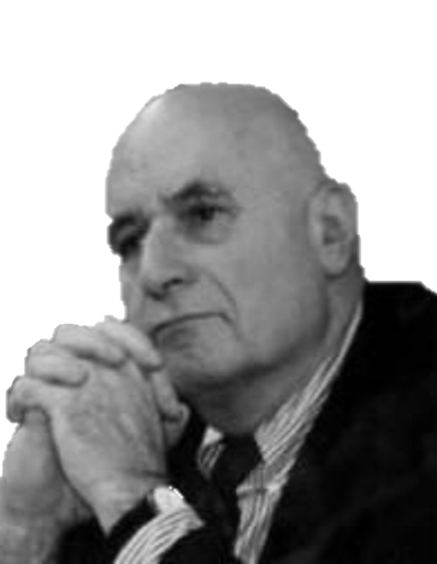
Peter Berger (again)
Invitation to Sociology
“The sociologist is someone concerned with understanding society in a disciplined way. ”

Slide 15
How To Be
a proper Sociological Detective…
Be scientific in your observations.
Be objective: control personal preferences
and prejudices.
Be interested in understanding for its own sake.

Slide 16
Investigating
This next sequence is one that eventually builds towards C Wright Mills’ notion of a Sociological Imagination. It does so by introducing an interesting idea floated by Foucault: that one of the main roles for sociologists is showing people how their behaviour both influences and is influenced by the social world into which they were born and live.
I’ve included Foucault’s quote because it strikes me as a very interesting way to both introduce students to this idea and open up various avenues for them to discuss this general idea - and perhaps apply it to their own lives and experiences.
Sociology
It’s one thing to be organised - to be systematic and objective in the way you investigate - but there’s another dimension to detection.
It’s an ability not everyone has - but it’s definitely something you can learn.
And for some sociologists it’s the most valuable skill we have...

Slide 17
Michel Foucault (1926 - 1984)
French academic.
And all-round Sociological baldass

Slide 18
Investigating
Sociology
“People know what they do”
“They frequently know why they do what they do”.
“But what they don’t know is what what they do does”.
And this is the idea we should follow…

Slide 19
Investigating
Sociology
“But what they don’t know is what what they do does”.
People fail, in other words, to understand how their choices have social consequences…
That reflect back on us and shape individual ideas and actions.
And this encourages us to explain people’s behaviour in personal terms…

Slide 20
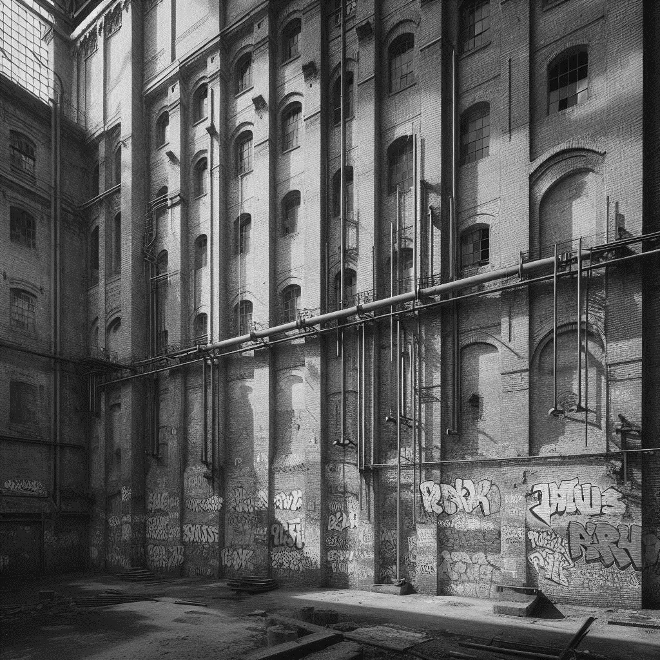
Investigating
Investigating
Sociology
I’ve included this screen as an opportunity to get students to identify and examine some of their own preconceptions about a range of social phenomena.
If you’re going to allow students to discuss any, some or all of the ideas listed you need to come prepared to show the social dimension - how crime, for example, is related to concepts like class, age, gender and ethnicity.
Alternatively, you might like to take a more-nuanced approach by focusing on something like divorce and showing the various social dimensions that influence individual decisions to divorce (marriage at a young age, religious beliefs about marriage, remarriage after previous divorce and the like).
You might also like to note that to leave this screen you need to first click the detective to bring-up the prompt for a sociological explanation. You can then leave the screen on the right edge.
Sociology
And if you don’t believe me?
How do you think most people in our society explain:
Crime?
Educational success?
Divorce?
Poverty?
Affluence?
Religious beliefs?
And how would a sociologist explain them?

Slide 21
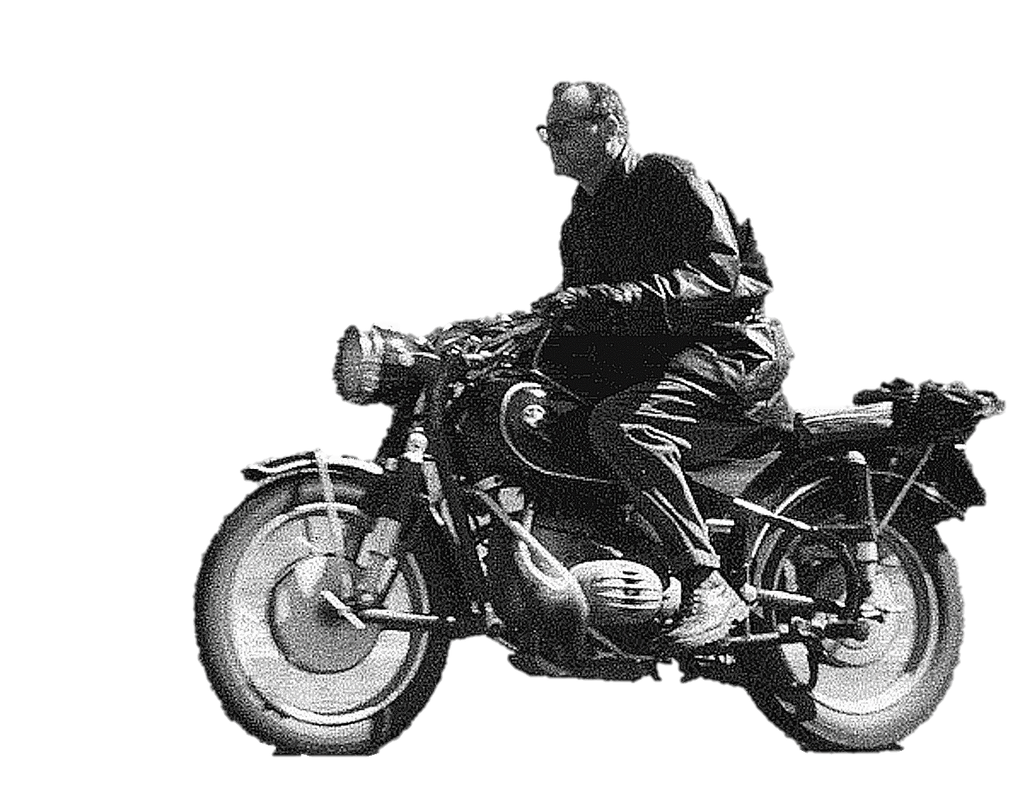
C Wright Mills (1916 - 1962)
On the off-chance that anyone bothers to ask “who’s the dude on the bike”, I’m (un)reliably informed that this was indeed C. Wright Mills being Sociologically Awesome.
I could be wrong.
Don’t quote me on that.
The Sociological Imagination
“Neither the life of an individual nor the history of a society can be understood without understanding both”

Slide 22
Investigating
Sociology
Sociological investigation involves understanding how the personal and the social interact.
If you can’t have a society without individuals…
Can you have individuals without society?
You may want to take a minute or two to think about it…

Slide 23
Investigating
If you want your students to discuss aspects of “the social” and “the biographical” just click each of the text boxes to bring-up an on-screen question for them to think about.
So, to understand the world we have to look beyond “the individual” and “the personal” to see the Bigger Picture…
Sociology
And that means connecting two ideas:
“The social” that involves understanding how a society has developed historically - and what this means for individuals.
How would your life have been different if you’d been born 200 years ago?
“The biographical” - the unique combination of life events and circumstances that give us our individuality.
How would your life be different if you had been born into a different gender, class or ethnicity?

Slide 24
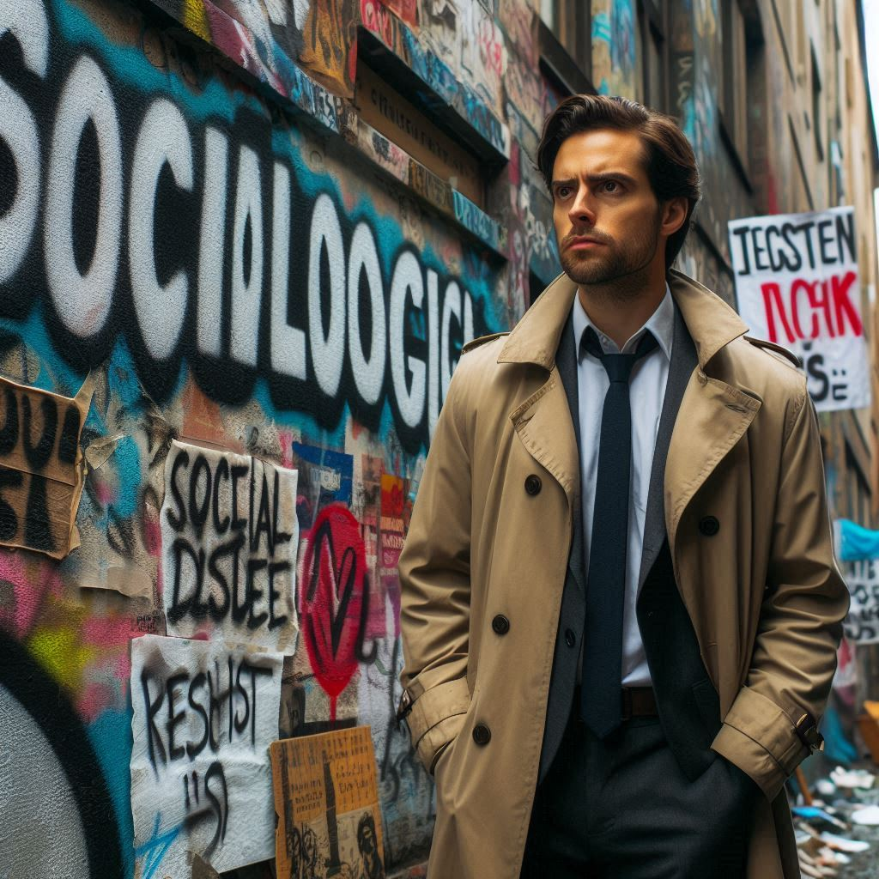
Investigating
Sociology
And our ability to see “The Bigger Picture” depends on developing a range of skills…
Analytical…
Observational…
Critical.

Slide 25
Investigating
Ask questions
Sociology
The final set of screens brings together all of the previous material by suggesting a number of different dimensions to the development of a Sociological Imagination.
It not only serves to wrap things up in a way that suggests there was, after all, a coherent plan underpinning this general Presentation but also allows you to do a couple of things:
Expand on the idea of a Sociological Imagination and how it can be developed (private troubles, public issues…)
2. Talk about the kinds of skills students will need to develop if they are to get the most out of their Sociology course and do well in any subsequent exams.
Whether you take these opportunities is, of course, up to you…
Oh, and to advance the slides just click on the safe…
Think like a detective and unlock your sociological imagination
Apply concepts critically…

Slide 26
Investigating
Analyse…
Sociology
In terms
Unlock your sociological imagination
Question common assumptions…
Because …

Slide 27
Investigating
Be systematic…
Sociology
Empathise…
Unlock your sociological imagination

Slide 28
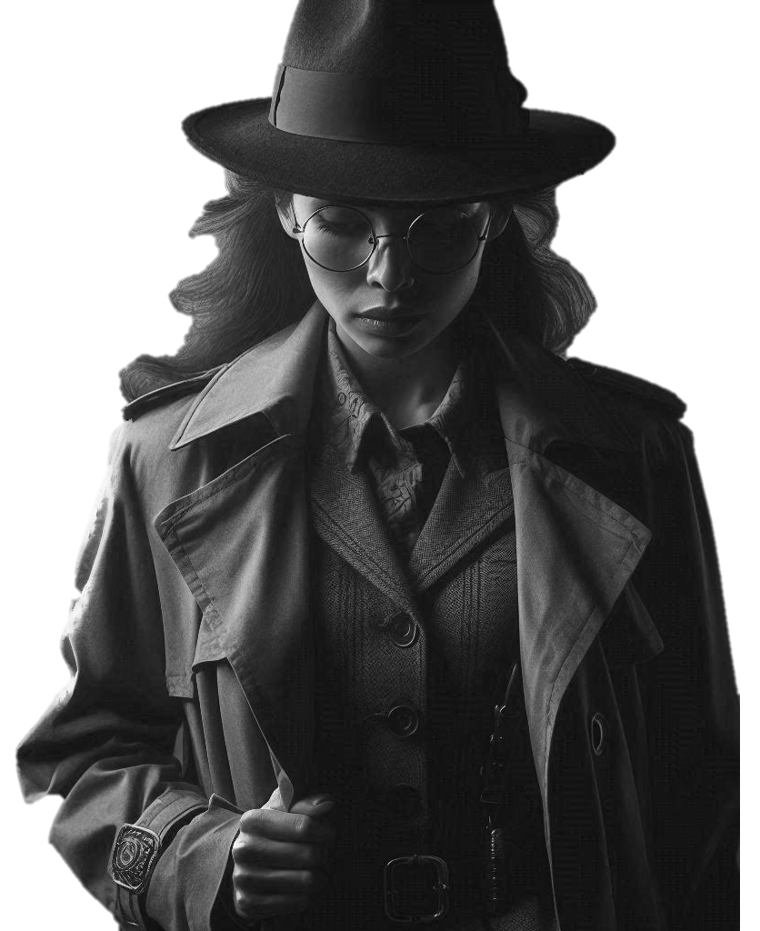

Slide 29
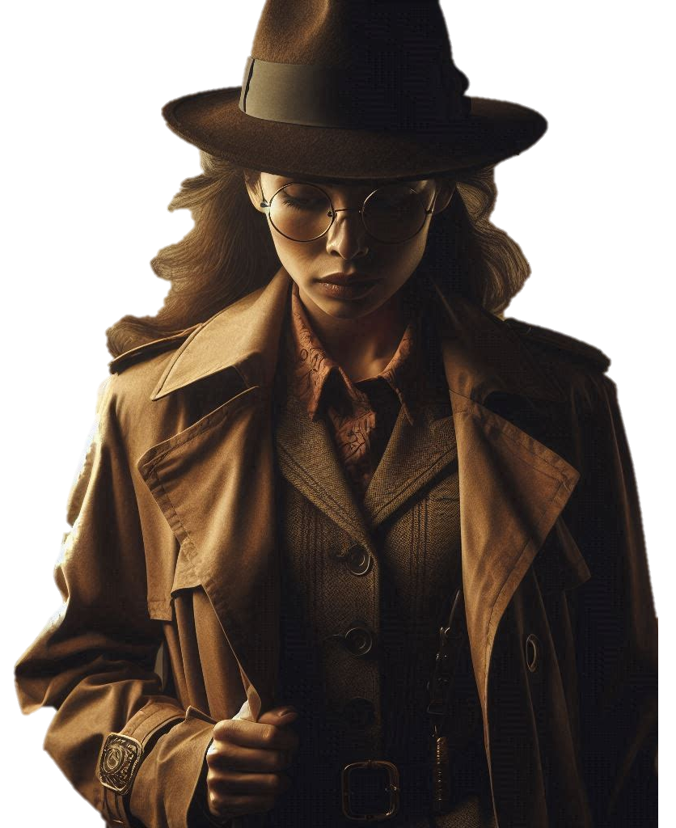
Investigating
Sociology

Slide 30
Written and Designed
(hard to believe I know)
by

Slide 31
Chris Livesey
©2024 shortcutstv.com

